Slide 1
PlanMoGPT: Flow-Enhanced Progressive Planning for Text-to-Motion Synthesis
Authors: Chuhao Jin, Haosen Li, Bingzi Zhang, Che Liu, Xiting Wang, Ruihua Song, Wenbing Huang, Ying Qui, Fuzheng Zhang, Di Zhang
Jun 2025
Presented by: Aye Myat Pan Htwar Paing

Slide 2
Introduction
LLMs have achieved breakthroughs in multimodal tasks.
In text-to-motion generation, LLM-based models lag behind diffusion methods.
Main challenge: motion tokenization granularity.
  Fine-grained : detailed but locally dependent.
  Coarse-grained : stable but loses detail.
Goal: Generate motion that is high-quality, semantically aligned, and diverse.

Slide 3
Research Problem
How to balance global coherence with fine motion details?
Existing methods:
  Fine-grained: causes local dependency
  Coarse-grained: misses important details

Slide 4
Methodology (PlanMoGPT framework)
Flow-Enhanced Motion Tokenizer
  Downsampling reduced (r=2) for higher temporal resolution.
  Larger codebook (4096) to capture details.
  Flow-matching decoder recovers motion nuances.
Progressive Planning with LLM
  Coarse-to-fine generation:
    4-frame = global plan/ rough skeleton
    2-frame = mid-level refinement
    1-frame = detailed sequence
  Allows error correction across levels

Slide 5
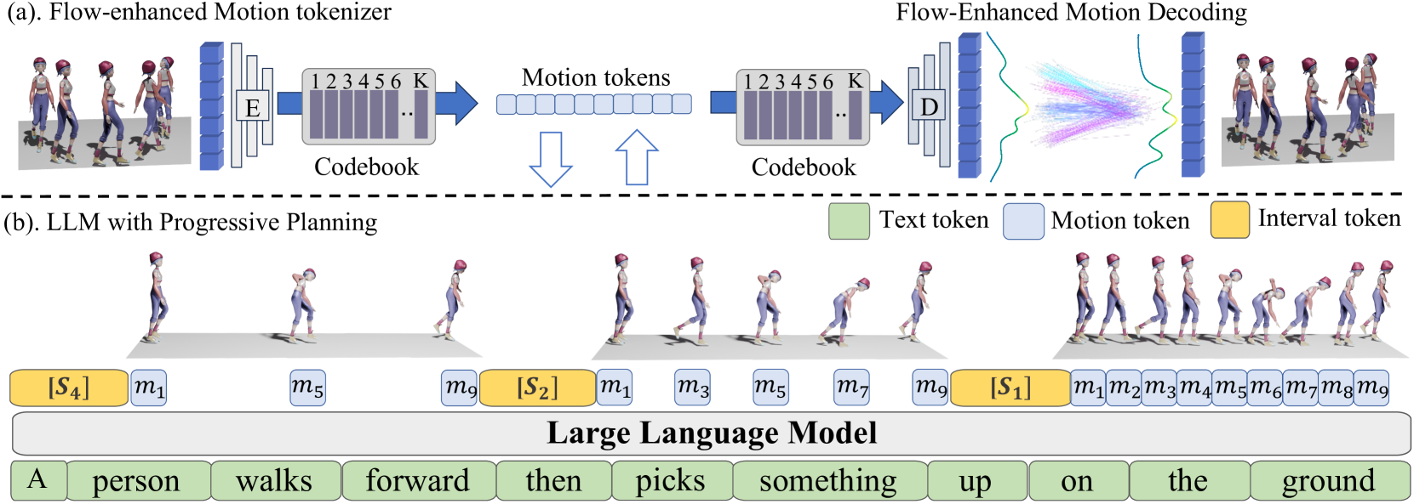

Slide 6
Key Findings
HumanML3D++ dataset:
  FID improved 0.380 to 0.141 (63.8% better)
  Motion diversity improved by 49.9%.
KIT-ML++ dataset:
  FID improved 0.425 to 0.230.
  Diversity also much higher.
Outperforms both diffusion-based and LLM token-based baselines.
Especially effective in long-sequence, complex motion generation.

Slide 7
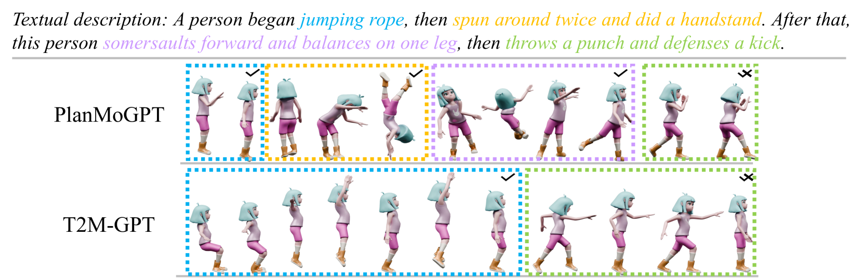

Slide 8
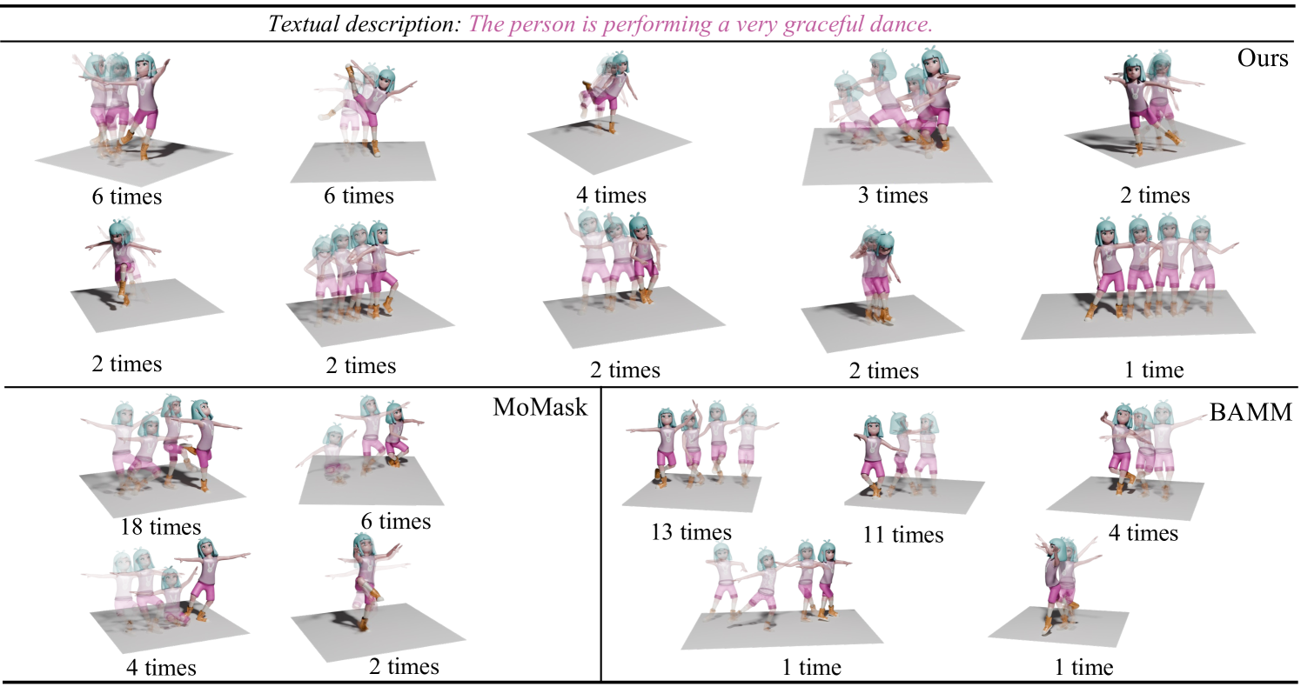
Different methods repeatedly generate 30 motions based on the same text. Similar motions are grouped and reported times.

Slide 9
Discussion
Progressive planning mitigates local dependency issues.
Flow-enhanced tokenizer preserves details while maintaining global consistency.
Balances motion diversity with generation quality.
Performs best on large-scale, high-resolution datasets (HumanML3D++)
Weaker performance on smaller datasets (KIT-ML)

Slide 10
Strengths and Weakness
Strengths:
State-of-the-art results across benchmarks.
Strong performance for long-sequence motion.
Solves diversity-quality trade-off.
Weaknesses:
Inference slower than some token-based baselines.
Suboptimal performance on small datasets.

Slide 11
Conclusion
PlanMoGPT integrates progressive planning with flow-enhanced tokenization.
Improves motion quality, diversity, and semantic alignment.
Outperforms both diffusion and token-based approaches.
Future Work: extend to facial expressions, hand motions, and interactive tasks.

