Slide 1
Multi-Objective Reinforcement Learning

Slide 2
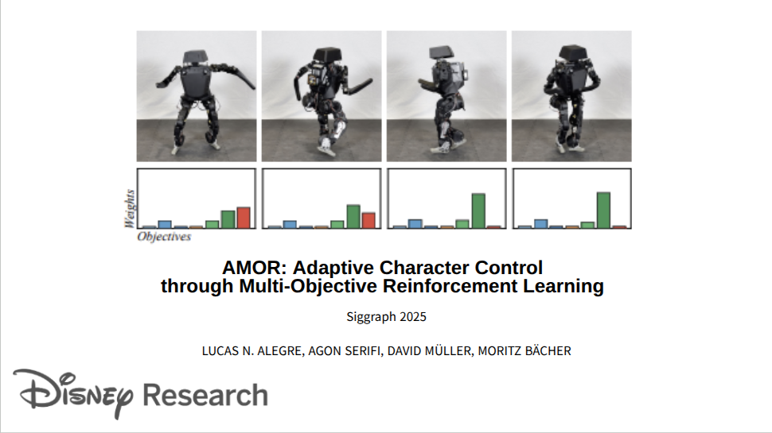
AMOR

Slide 3
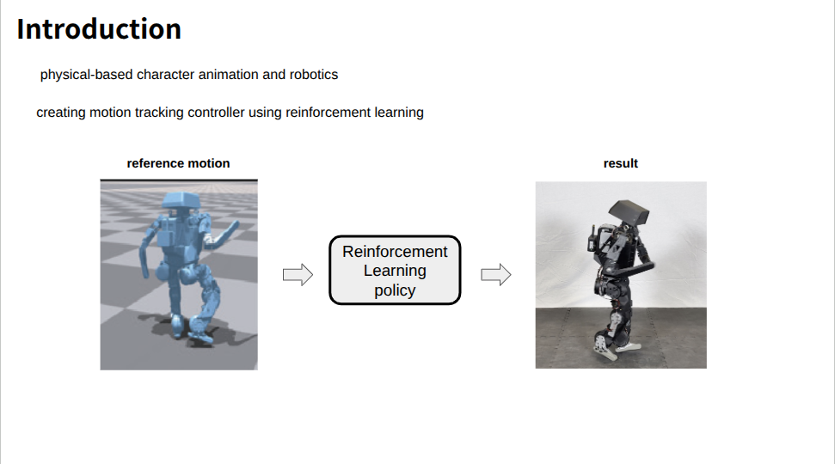
AMOR

Slide 4
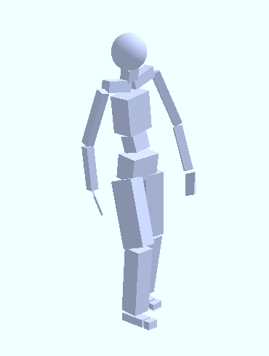
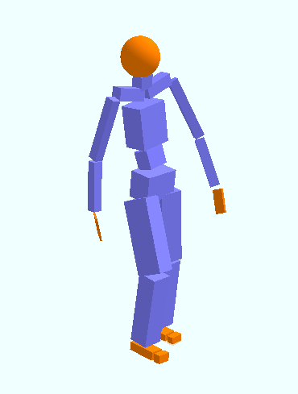
Gait reconstruction
reference motion
result
Reinforcement Learning policy

Slide 5
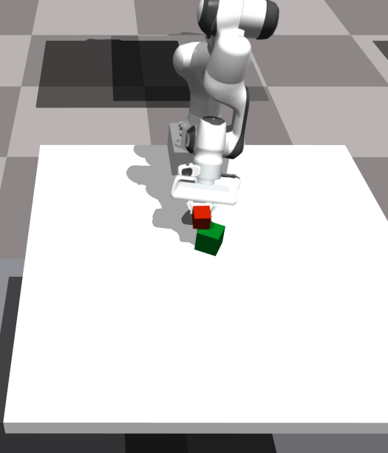
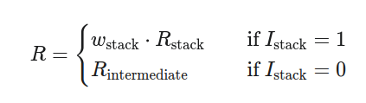
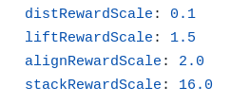
Reward function
FrankaCubeStack

Slide 6
Reward function
FrankaCubeStack

Slide 7
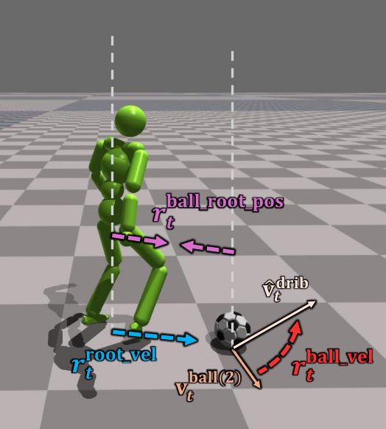
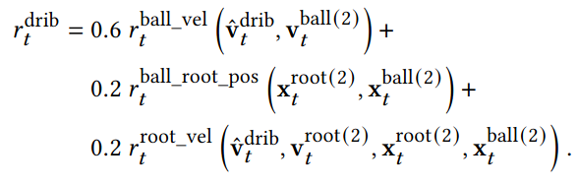
Reward function
PhysicsFC

Slide 8
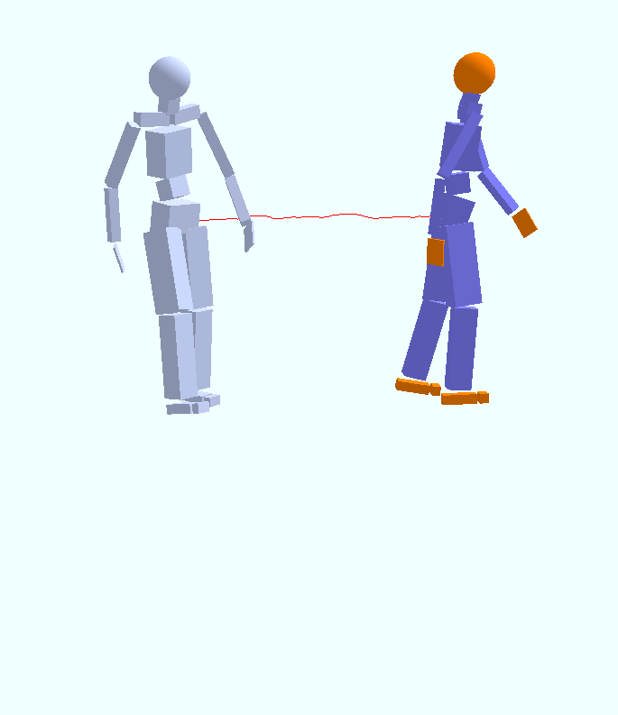
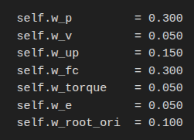
Reward function
Gait reconstruction

Slide 9
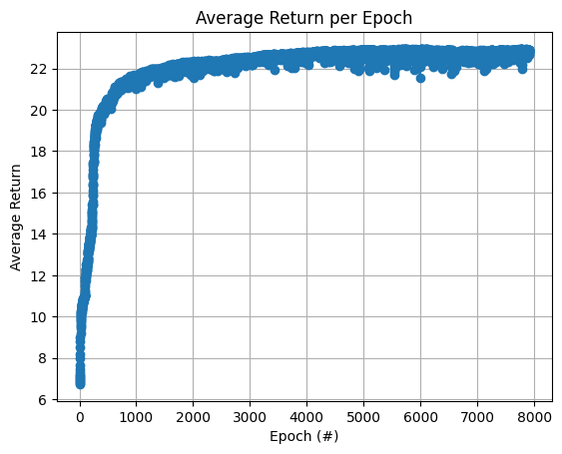
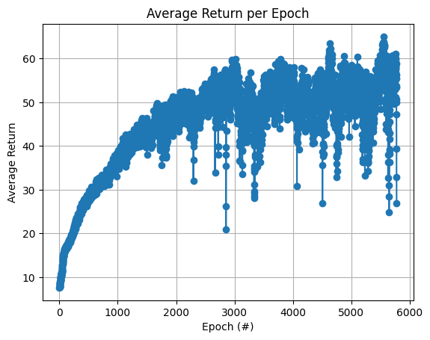
Reward weight

Slide 10
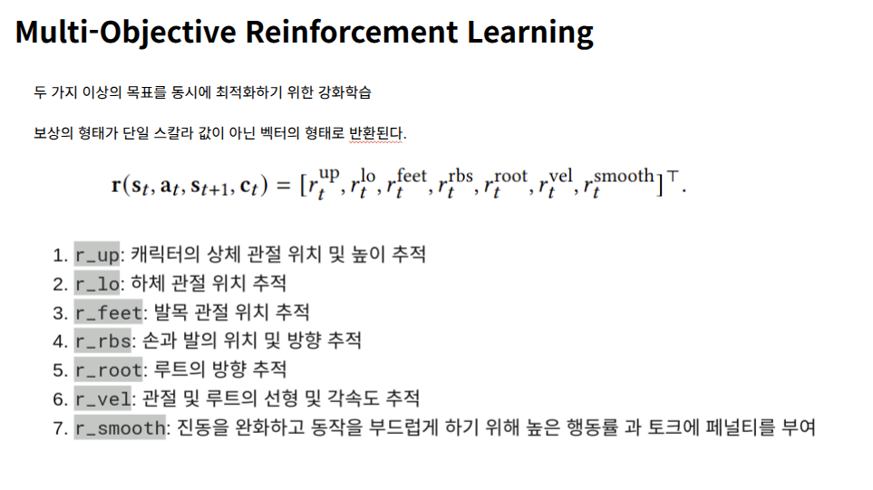
AMOR

Slide 11
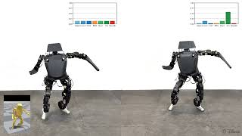
AMOR

Slide 12
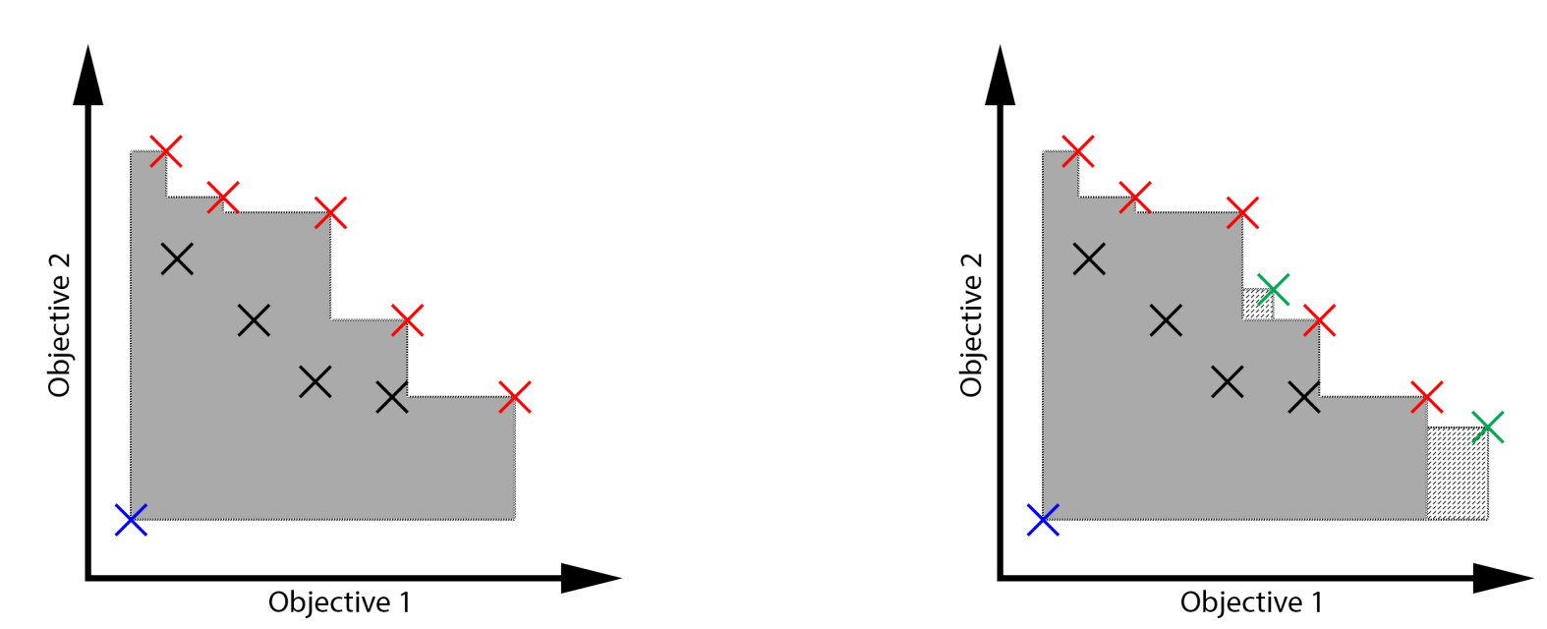
A Practical Guide to Multi-Objective Reinforcement Learning and Planning
AAMAS 2022
(Autonomous Agents and Multi-Agent System)
Conor F. Hayes, Roxana Rădulescu,Eugenio Bargiacchi . . .
Notes:
Autonomous Agents and Multi-Agent Systems

Slide 13
MORL
Why use multi-objective reinforcement learning?
Limitations of the Current method
Manual process
Places an excessive burden engineers
Damages the explainability of decision making process
Cannot handle all types of preferences
Preference between objectives may change over time

Slide 14


MOMDP
S: state space
A: action space
T: S x A x S -> [0, 1] is a probabilistic transition function
: [0, 1) discount factor
: probability distribution over initial state
R: vector-valued reward function

Slide 15
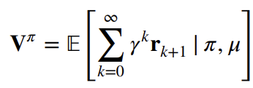



Policies and Value function
Multi-Objective setting, the value function does not provide a complete order

Slide 16
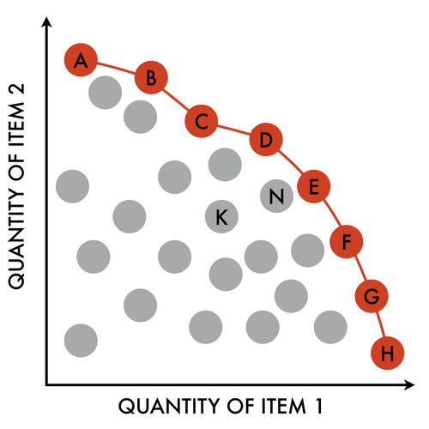
Pareto Front

Slide 17
Pareto Front
I

Slide 18
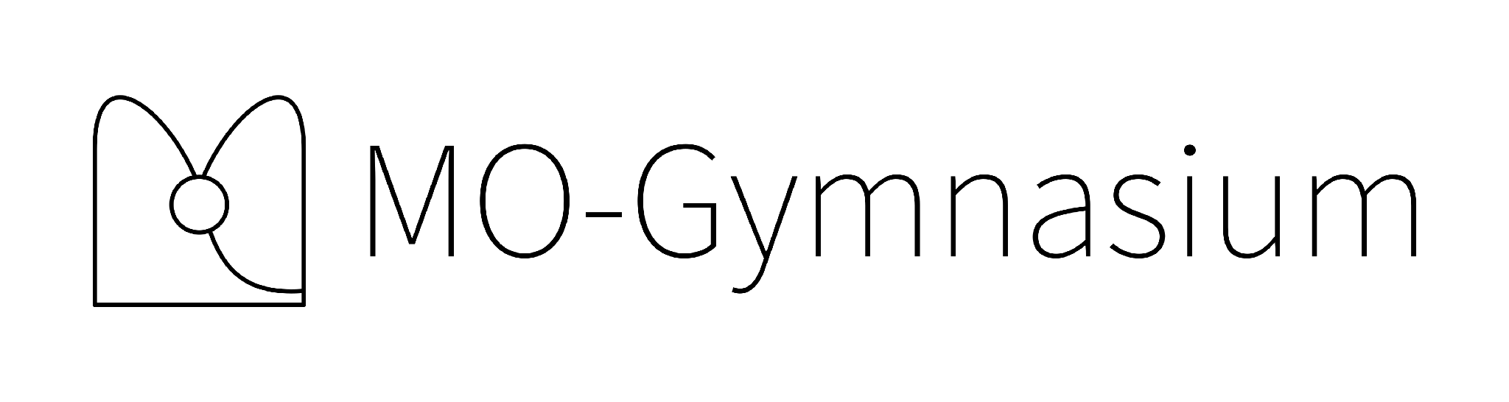
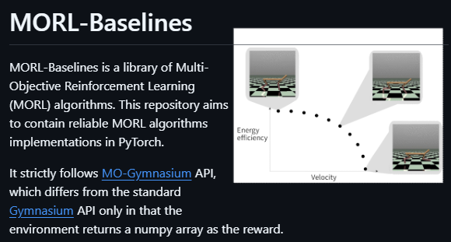
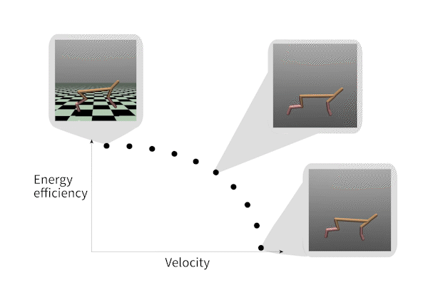
plan.

