Slide 1

Animating the Uncaptured: Humanoid
Mesh Animation with Video Diffusion Models
Paper Review 202524211 권초염

Slide 2
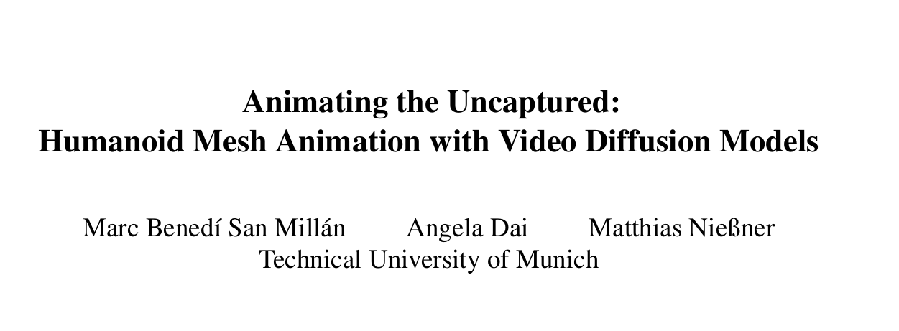

Slide 3
Motivation & Goal
Character animation is essential in movies, games, VR, and robotics
Motion capture is expensive and requires professional studios and actors
Manual animation demands frame-by-frame efforts, which is inefficient and time-consuming
Collecting large-scale realistic and diverse human motions is extremely difficult
Existing data-driven approaches depend on limited 4D MoCap datasets, which lack generalization ability
How can we generate realistic and natural motions for static 3D humanoid meshes without relying on massive MoCap data?

Slide 4
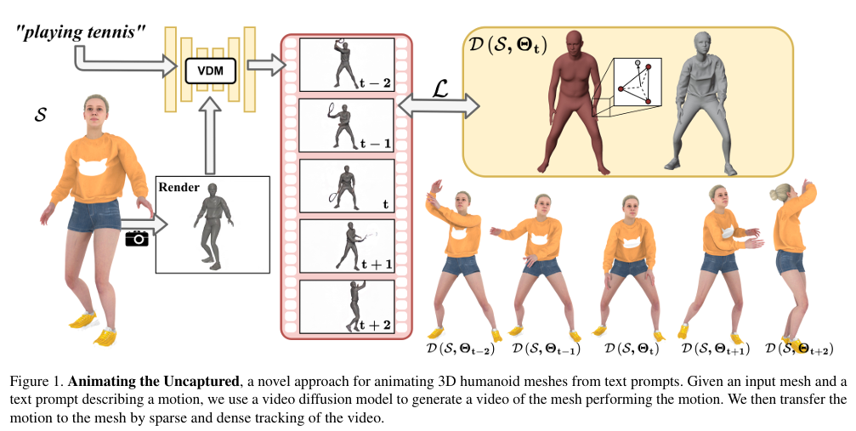
Motivation & Goal
Does not rely on expensive motion capture, achieving low cost
Leverages the rich priors of VDM-based motion generation for diverse motions
Enables applications in games, virtual humans, films, and interactive experiences

Slide 5
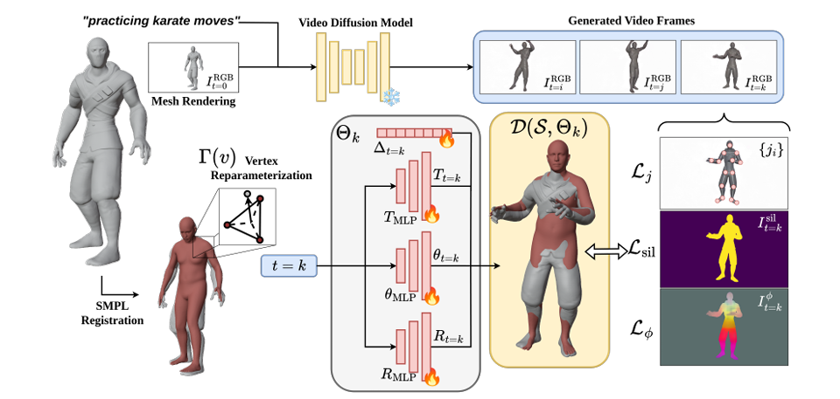
Method Overview
Take a static mesh and a text prompt as input
Use VDM to generate a video by combining mesh renderings with the text description
Register the mesh to SMPL to establish vertex correspondences
Track motion from the generated video by extracting landmarks, silhouette, and dense features
Optimize pose, translation, rotation, and offsets using an MLP with multiple loss terms
Produce an animated mesh performing the target motion as output

Slide 6
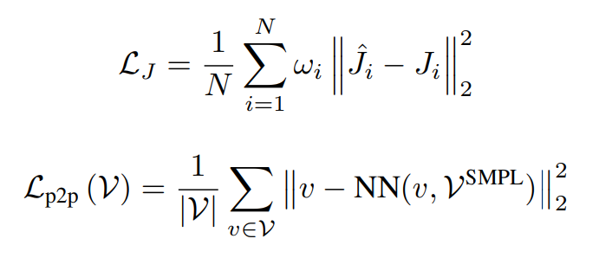
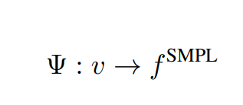
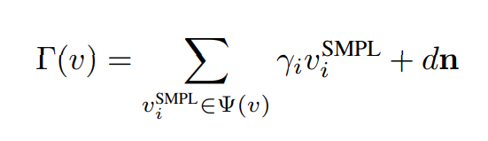
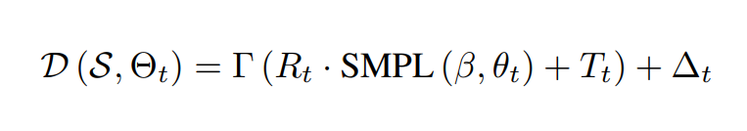
Registration & Proxy
SMPL Registration
Aligns the skeleton with the mesh joints
Matches the surface with the mesh geometry
SMPL as a Deformation Proxy
Each mesh vertex is mapped to its nearest SMPL surface
Each mesh vertex is computed from its SMPL triangle vertices with an added normal offset
Produces a reasonable SMPL proxy for the input mesh

Slide 7
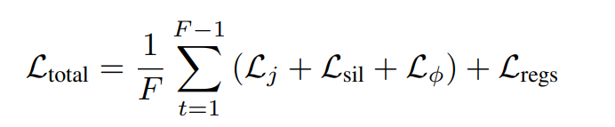
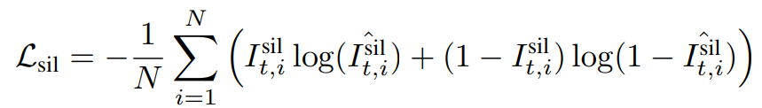
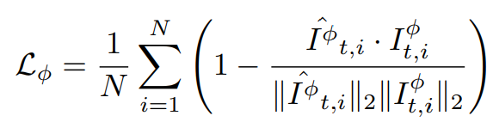
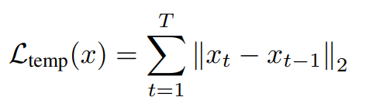
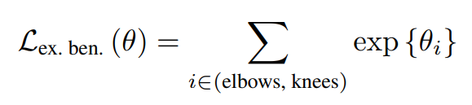
Loss Terms
Binary cross-entropy encourages predicted silhouettes to match the ground truth masks
Dense feature loss enforces semantic correspondence between local regions of the mesh and video
Temporal loss smooths motion trajectories and reduces jitter from noisy landmarks
Exponential loss penalizes unnatural poses

Slide 8
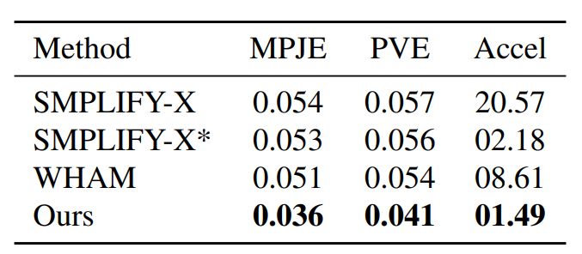
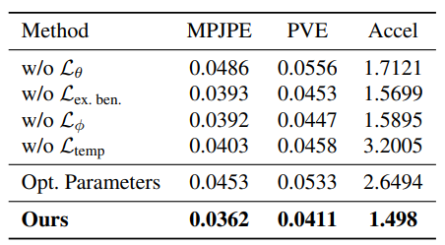
Evaluation
MPJE -> Mean-Per-Joint-Position-Error
PVE -> PerVertex-Error
Accel -> Acceleration Error
SMPlIFY-X* -> SMPLIFY-X + temporal smoothing
Pose prior keeps the motion in correct shape and reduces joint errors
Temporal smoothness keeps the motion stable and prevents jitter

Slide 9
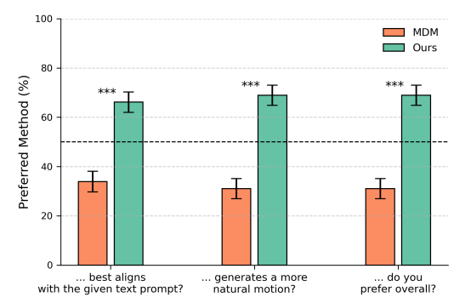
Evaluation
• Q1: ”Which motion looks more realistic?”
• Q2: ”Which motion aligns better with the text prompt?”
• Q3: ”Which motion do you prefer overall?”

Slide 10
Conclusion & Limitations
VDM may produce morphing artifacts in generated motions
Monocular tracking is underconstrained and prone to ambiguities and errors
(during video tracking)
Future work may incorporate depth predictors or multi-view diffusion models to improve the results
The approach has the potential to generate large-scale 4D motion data for training and evaluation

