Slide 1
LAM: Large Avatar Model for One-shot Animatable Gaussian Head (SIGGRAPH 2025)
Authors: Yisheng He, Xiaodong Gu, Xiaodan Ye, Chao Xu, Zhengyi Zhao, Yuan Dong, Weihao Yuan, Zilong Dong, Liefeng Bo
Affiliation: Tongyi Lab, Alibaba Group China
DU XIAN
2025-08-19
Dept. of AI - CGL

Slide 2
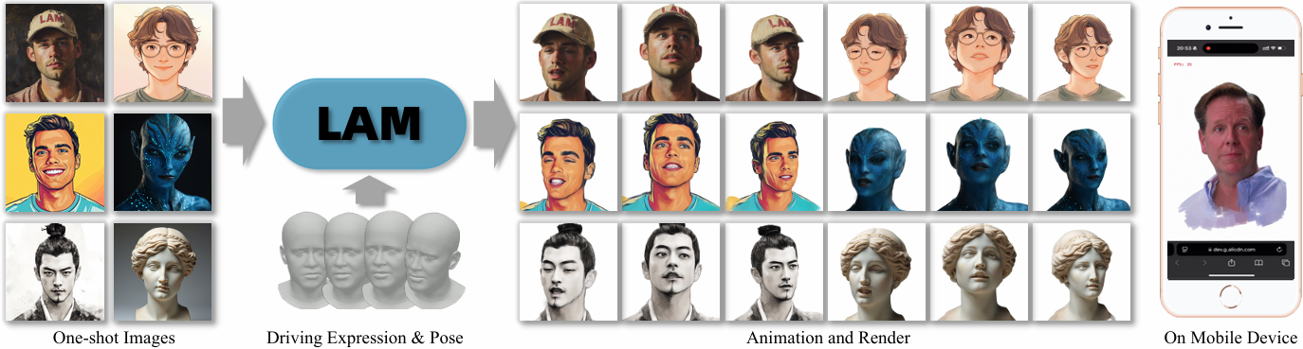
LAM
LAM creates animatable Gaussian heads with one-shot images in a single forward pass.
The reconstructed Gaussian avatar can be reenacted and rendered on various platforms in real time.
Notes:
https://www.youtube.com/watch?v=FrfE3RYSKhk
https://aigc3d.github.io/projects/LAM/

Slide 3
Introduction
Research Background:
Reconstructing animatable 3D head avatars from a single image is critical for applications like VR, gaming, and video conferencing.
Limitations of Existing Methods:
2D methods: Lack 3D consistency; slow rendering.
NeRF-based 3D methods: Require extensive optimization; slow rendering.
Gaussian Splatting methods: Depend on 2D post-processing networks, limiting platform compatibility.
LAM’s Innovation:
Generates animatable Gaussian avatars in one forward pass, enabling real-time animation/rendering on diverse devices (including mobile).

Slide 4
Contributions
A large avatar model for one-shot generation of animatable Gaussian heads, with no need for post-processing.
Seamless integration into traditional rendering pipelines, supporting real-time performance across platforms.
Extensions: Text-to-animatable avatar generation and style editing.
State-of-the-art results on benchmark datasets.

Slide 5
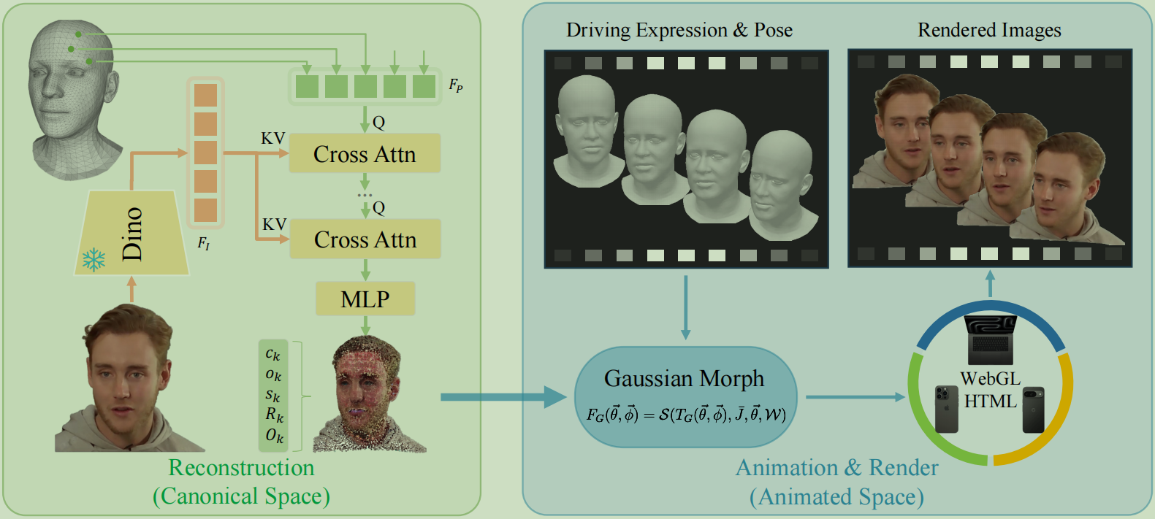
Methodology
Core Idea: Reconstruct a canonical Gaussian avatar using FLAME model priors, then animate it via linear blend skinning (LBS).
Workflow:
Extract multi-scale image features using DINO.
Use Transformer with cross-attention to predict Gaussian attributes (color, opacity, scale, rotation) in canonical space, initialized from FLAME vertices.
Animate via FLAME’s LBS and corrective blendshapes.
Render in real time using Gaussian Splatting.

Slide 6
Technical Details
Canonical Space Reconstruction:
Unifies pose/expression in a canonical space to simplify animation.
Uses explicit point clouds initialized from subdivided FLAME vertices for detail preservation.
Transformer Architecture:
Cross-attention between FLAME vertex features and multi-scale image features to enhance texture/shape fidelity.
Animation Pipeline:
Leverages FLAME’s LBS and blendshapes, avoiding extra neural networks.

Slide 7
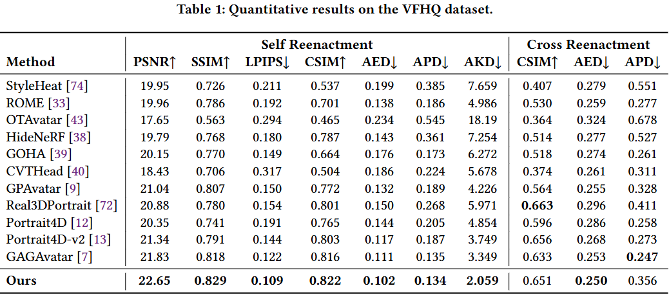
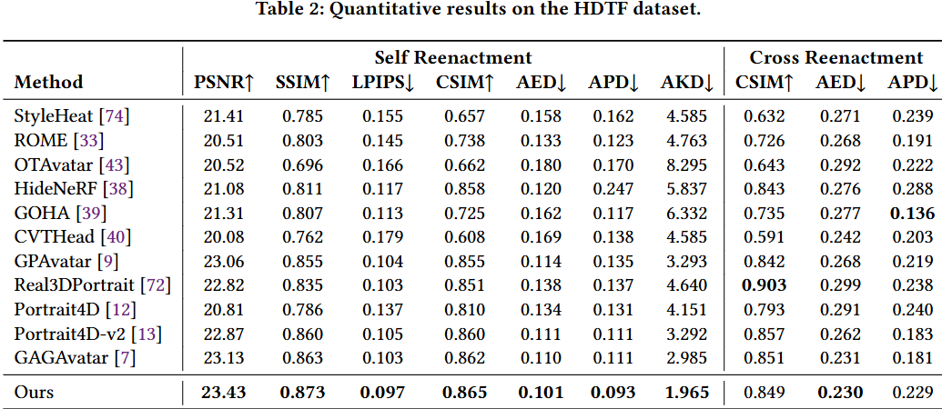
Experiments
Datasets:
VFHQ and HDTF.
Metrics:
Image Quality:
PSNR, SSIM, LPIPS
Identity Consistency:
CSIM
Expression/Pose Accuracy:
AED/APD/AKD

Slide 8
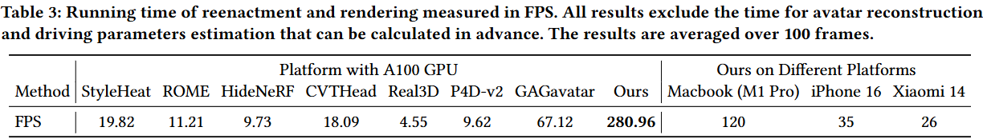
Experiments – Speed & Deployment
Rendering Speed:
280.96 FPS on A100 GPU (vs. GAGAvatar’s 67.12 FPS).
Real-time on mobile (120 FPS on iPhone 16, 35 FPS on Xiaomi 14).
Deployment:
WebGL-based implementation for cross-platform compatibility (web browsers, mobile).

Slide 9
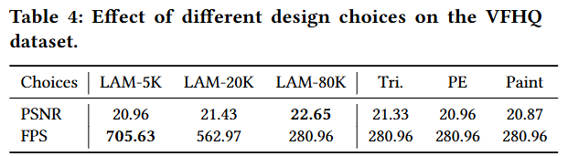
Ablation Studies
Effect of Different Number of Gaussian Points.
80K points provide optimal balance between detail (hair, mustache) and speed (280.96 FPS).
Effect of Query Representation.
Point-based queries outperform triplane-based methods with the same point count.
Effect of Canonical Space Generation.
Unified canonical space simplifies reconstruction and improves animation quality.
Effect of Cross-Attention on Image Features.
Direct image feature cross-attention enhances texture and shape fidelity over painted features.

Slide 10
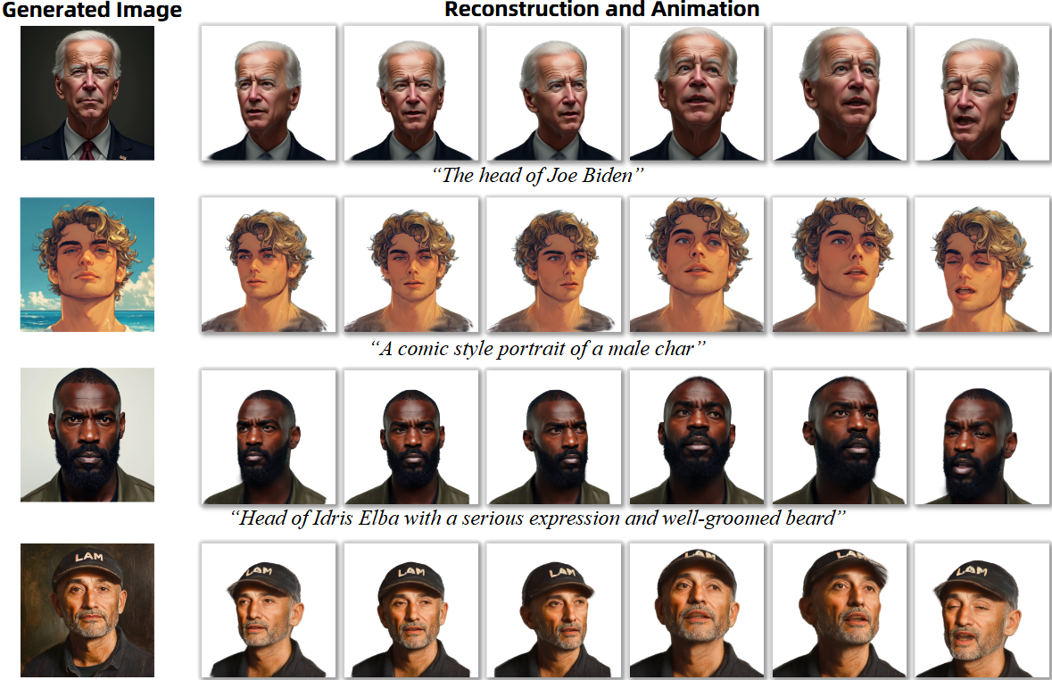
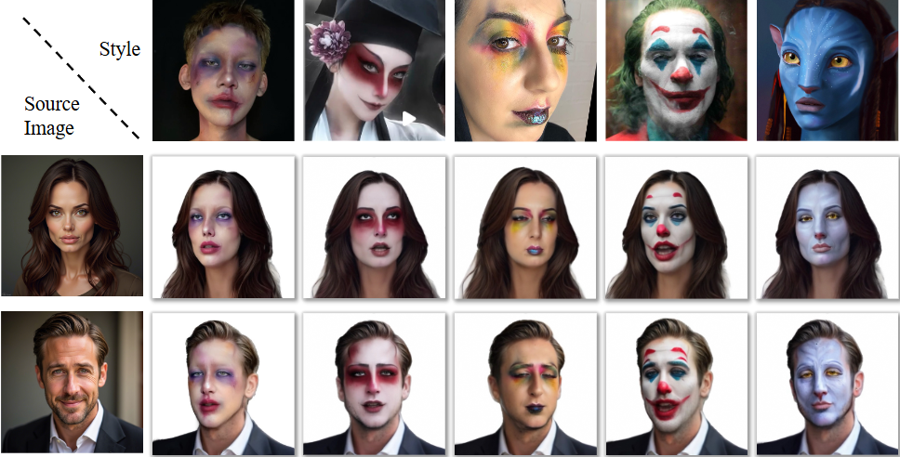
More Applications
Style Editing: Modify avatars (e.g., age, cartoon style) using image-to-image translation, then reconstruct with LAM.
Text-to-Animatable Avatar: Generate avatars from text prompts via Stable Diffusion + LAM.

Slide 11
Conclusions and Limitations
Conclusions:​​
Novel one-shot animatable Gaussian head model with Transformer core.
Uses FLAME point-cloud, multi-scale cross-attention, unified space for efficient reconstruction.
Real-time rendering on mobile via existing pipelines.
Supports text-to-avatar & single-image style editing.
​​Limitations:​​
FLAME-dependent (e.g., no tongue movement).
No 2D post-processing → misses dynamic details (e.g., wrinkles).
Limited expression neutrality & single-image challenges.
FLAME estimation errors impact results.

Slide 12
Thanks!
~~

