Slide 1

Intersection-Free Garment Retargeting
Paper Review 202524211 권초염

Slide 2
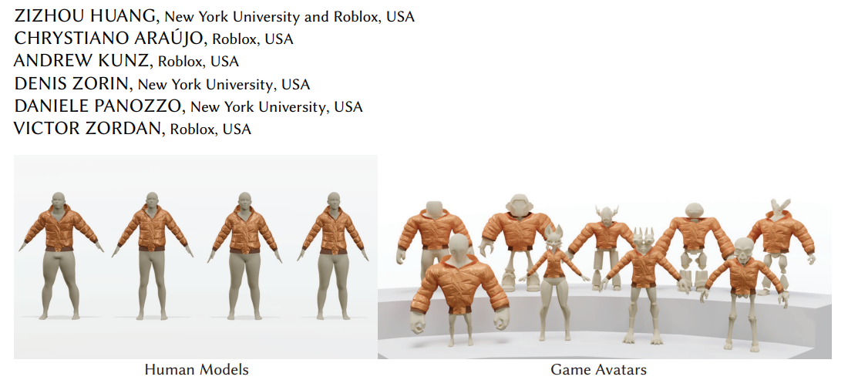


Slide 3
Motivation & Goal
Existing garment retargeting
Most existing methods are designed for human avatars
Only work reliably under small body shape variations
Not suitable for non-human, disconnected, or unrealistic topologies
However, avatars in games and animation are often diverse and unconstrained
There is a strong need for a generalized and automated retargeting method
Goal
Adapt garments to a wide range of non-human avatars
Ensure no self-intersections and no collisions between garment and body

Slide 4
Method Overview
Input
Standard humanoid avatar wearing a garment
Target avatar
Output
Automatically retargeted garment
Preserve design + intersection-free
Simulation-ready for downstream applications

Slide 5
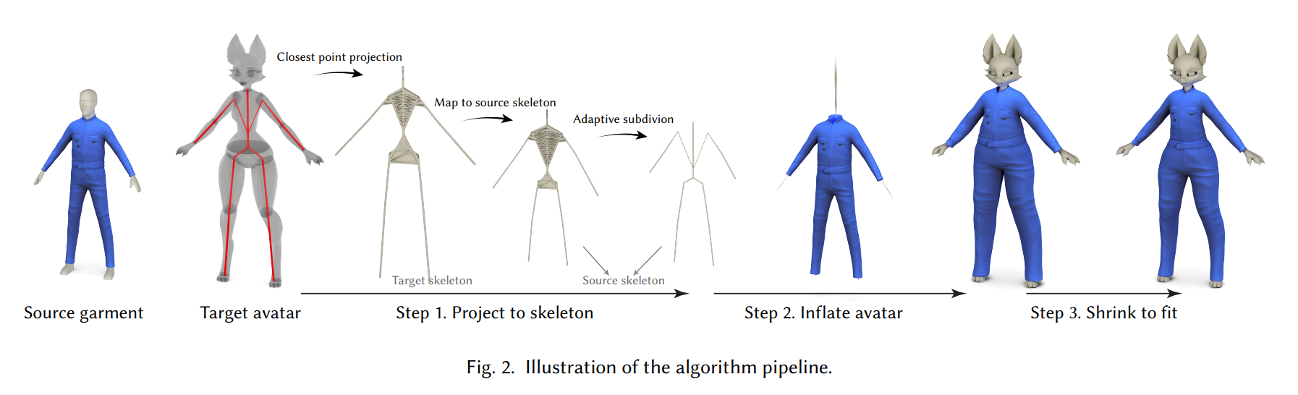
Method Overview
Skeleton Alignment & Embedding
Progressive Shape Expansion + Collision-aware Optimization
Garment Refinement

Slide 6
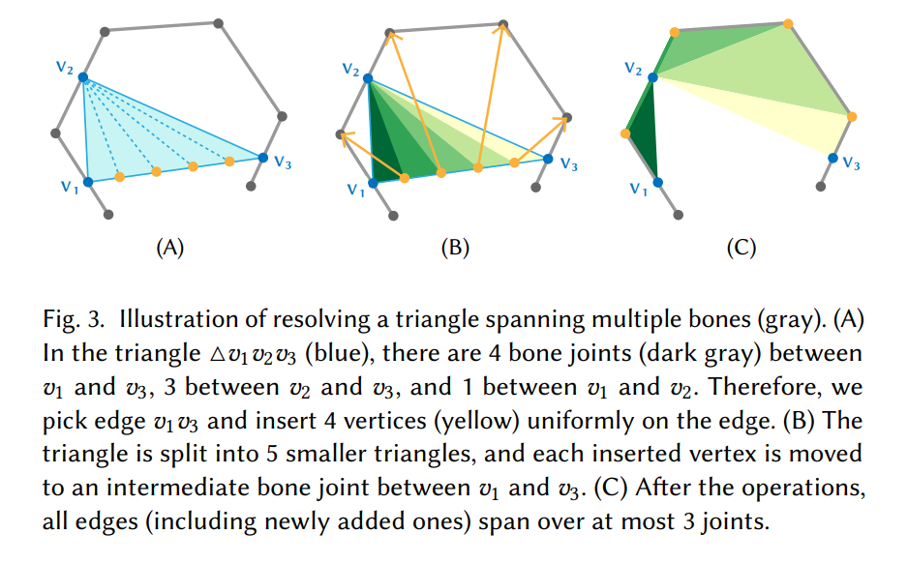
Intersection-Free Initialization
Use skeleton-based mapping and local projection
Prevent interpenetration from the initial stage
Adaptive subdivision for stable and smooth deformation

Slide 7
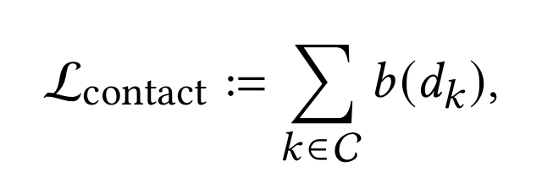
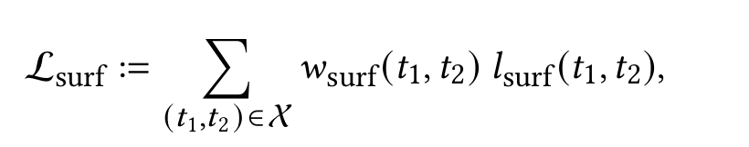
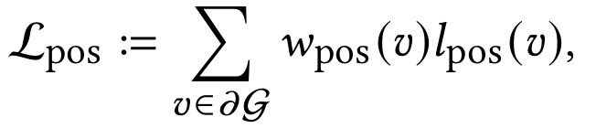
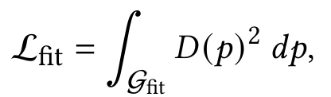

Multi-objective Optimization Framework
L_contact : Contact-Aware Optimization
- Avoiding unrealistic penetration or detachment
L_surf : Surface Consistency
- Maintaining smooth and coherent surface transition
L_pos : Relative Position
- Preserving spatial relation between garment and body
L_fit : Geometric Fitting
- Ensuring close geometric fit to target mesh
L_curve : Curvature & Torsion
- Maintaining natural curvature and draping

Slide 8
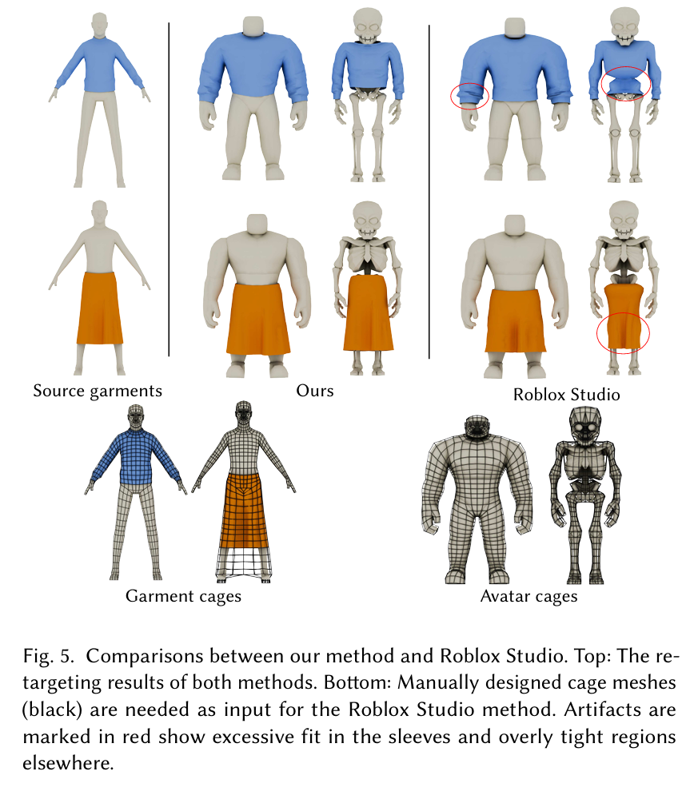
Comparison with Roblox Studio
Roblox Studio requires manual cage design, high effort, rigid fit
Our method automates the entire process with skeleton-aware fitting
Roblox often causes unnatural squeezing and distorted shapes
Ours preserves natural folds and garment structure, especially for complex items like skirts and puffy jackets
Roblox focuses on attachment
Ours focuses on realistic drape and deformation, which brings higher visual and practical value

Slide 9
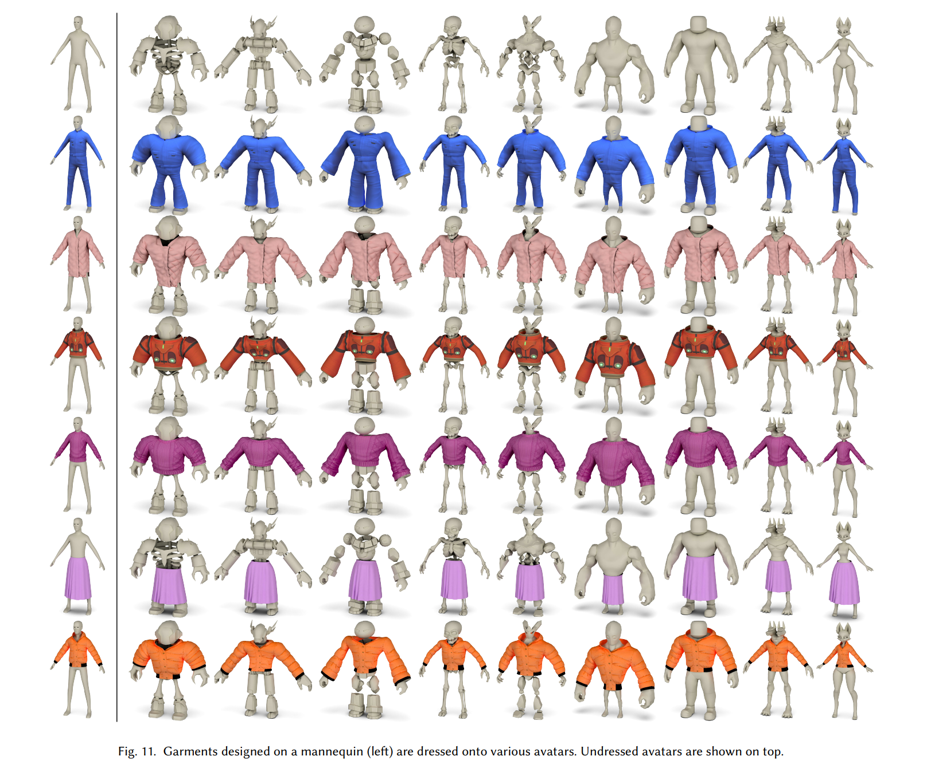
Generalization across Diverse Avatars
No manual intervention
Design and structure preserved
No interpenetration or garment failure
Natural skirt draping
Preserved puffer volume
Knitted folds and structure retained
（Top row: Unclothed target avatars）
（Left column: Reference body）

Slide 10
Conclusion & Limitations
Achievements
No Interpenetration
No Training Required
Generalizable
Simulation Ready
Limitations
Skeleton Dependency
Mesh conditions

