Slide 1
Research Progress
Learning Character-Agnostic Motion for Motion Retargeting in 2D
(SIGGRAPH 2019)
2025-07-15
DU XIAN
Computer Graphics Lab
Ajou University

Slide 2
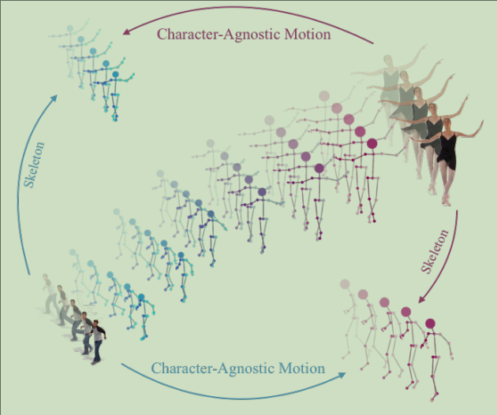
Key Points
2D Motion Retargeting without 3D Reconstruction
Works directly on 2D videos
Learns to separate:
  Motion (what moves)
  Skeleton (body proportions)
  View angle (camera direction)
Can mix and recombine these parts
Transfers motion between different characters
The method extracts character-agnostic 2D motion from two videos and transfers it to new skeletons/view angles (top-left & bottom-right).
It also disentangles motion, skeleton, and
view-angle representations for controllable interpolation.

Slide 3
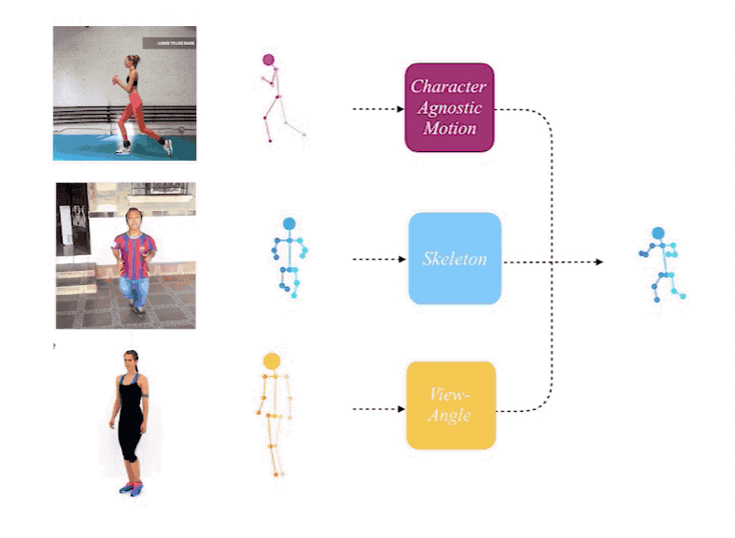
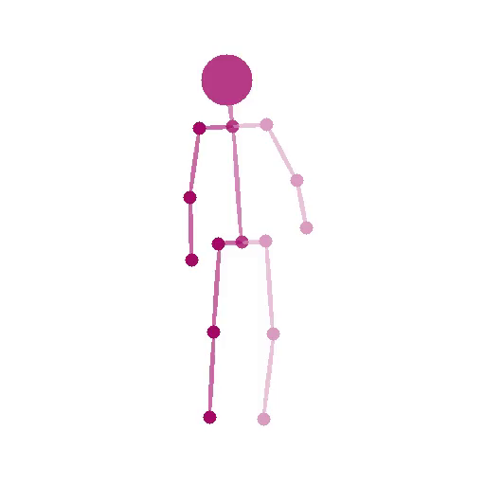
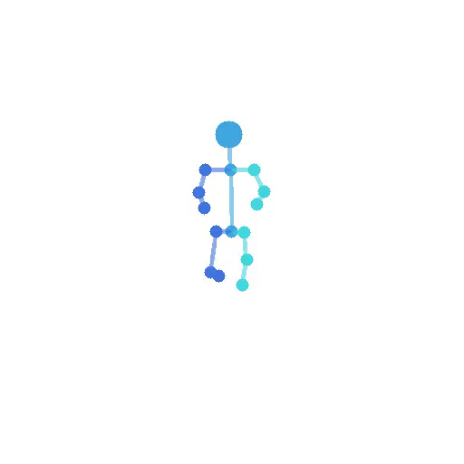
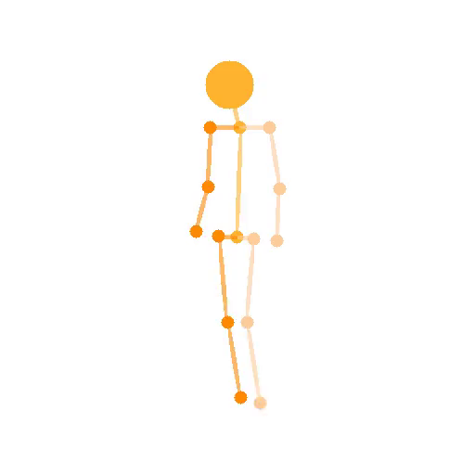
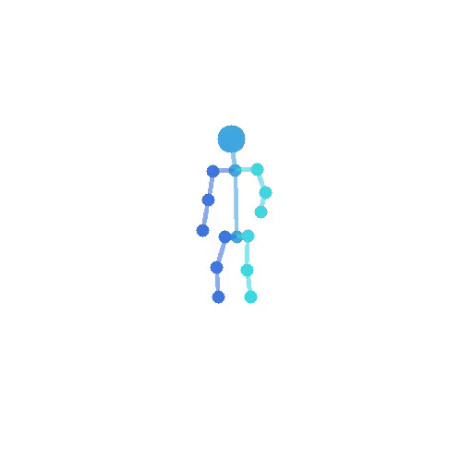
Demo Examples - 1
Motion
Skeleton
View angle
Input
output
Run the full model to combine motion, skeleton, view angle from three input videos

Slide 4
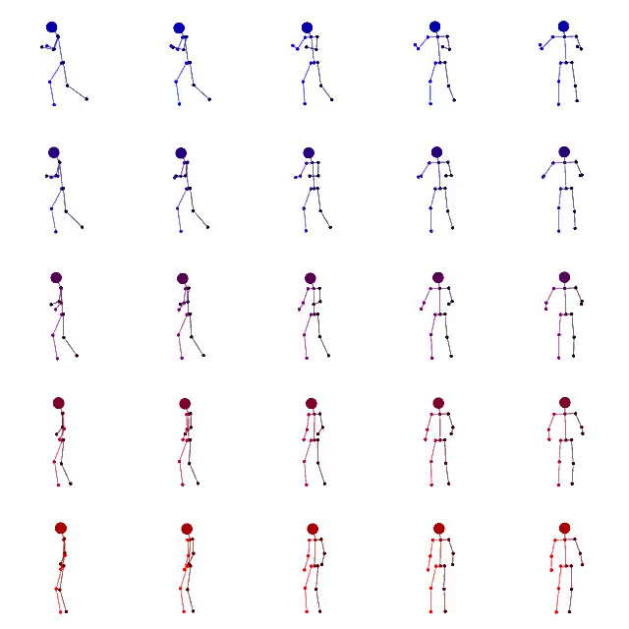
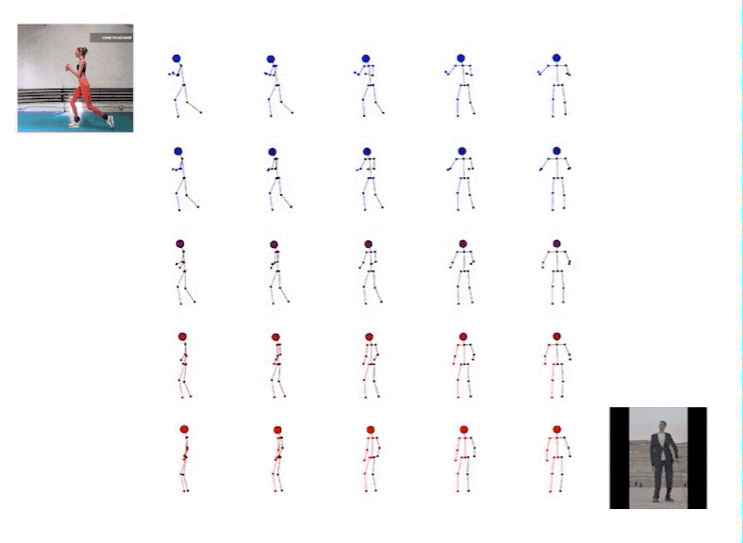
Demo Examples - 2
Run the full model to do interpolation
between two input videos.
For example, to keep body attribute unchanged,
and interpolate in motion and view axis:

Slide 5


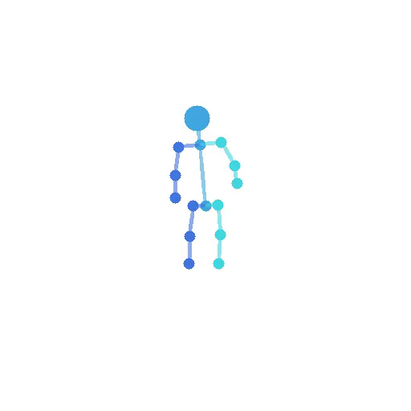
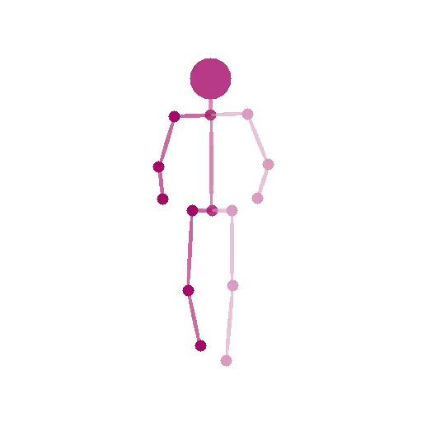
Demo Examples - 3
Run two encoder model to transfer motion and skeleton between two input videos:
input1
input2
out12
out21

Slide 6
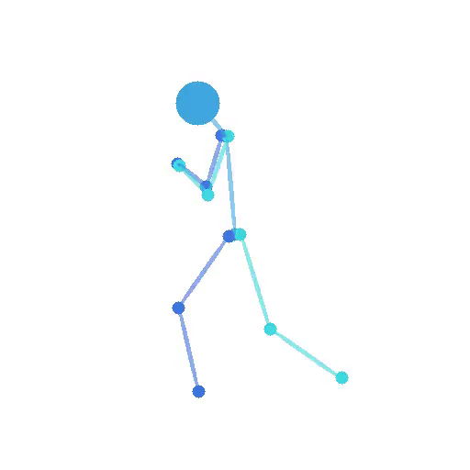
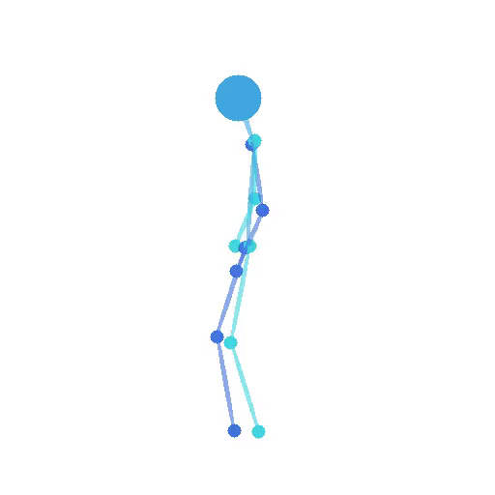
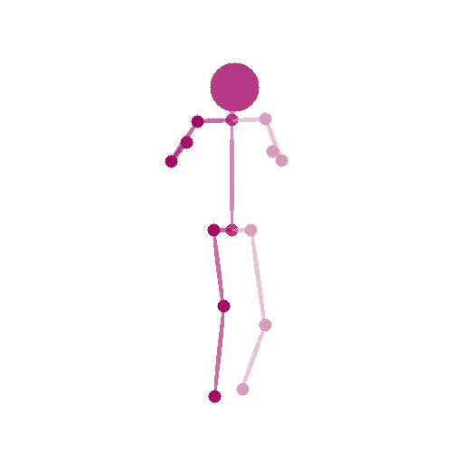
Demo Examples - 4
Run two encoder model to transfer motion and view angle between two input videos:
input1
input2
out12
out21

Slide 7
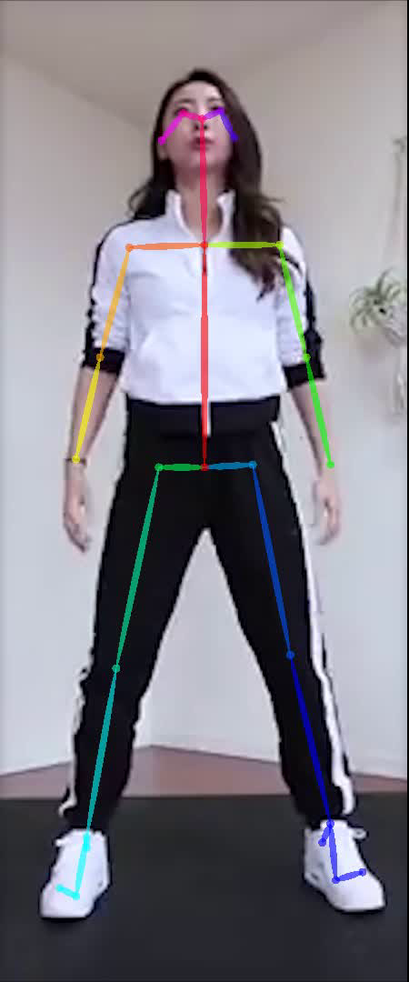
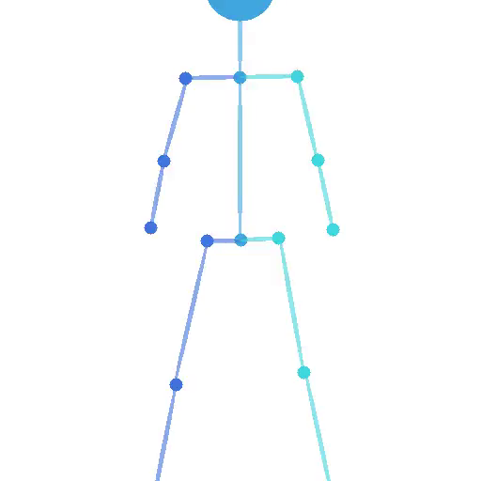
Use our videos
Pipeline:
Extract 2D skeletal data (JSON)
from videos using OpenPose,
feed into the model,
and generate outputs.
​​Implementation steps:
Video →
OpenPose →
JSON →
Model →
Output

Slide 8
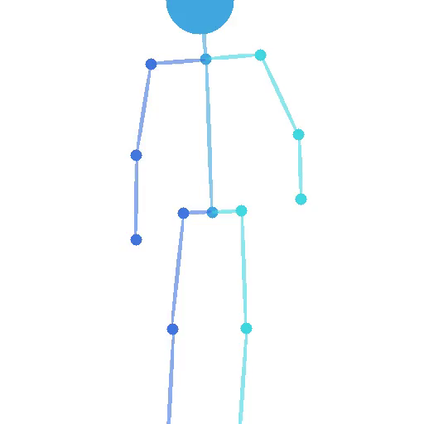
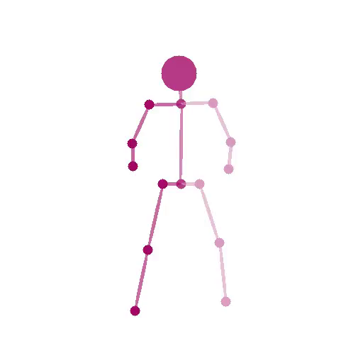
Use our videos
Run two encoder model to transfer motion and skeleton between two input videos:
input1
input2
out12
out21

