Slide 1
Leaning Character-Agnostic Motion for Motion Retargeting in 2D
SIGGRAPH 2019
DaeYong Kim
Dept. of Artificial Intelligence, Ajou University

Slide 2
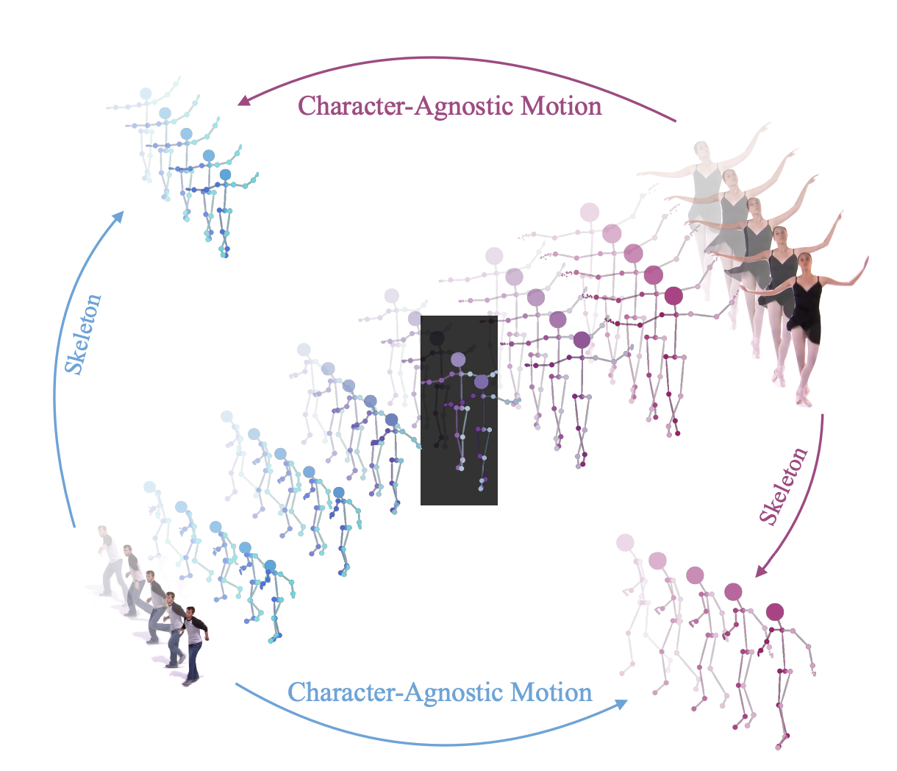
Retargeting
Introduction
Goal
Dynamic
  Motion
Static
  Skeleton
  view
Motion Attributes

Slide 3
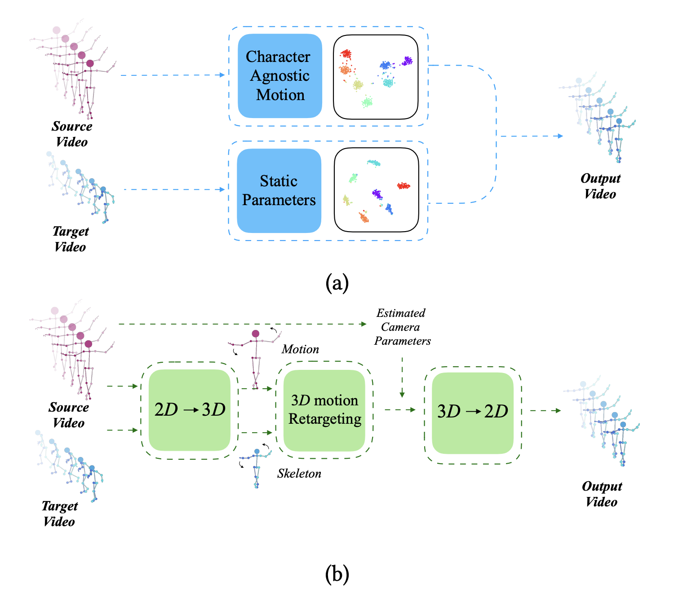
Introduction

Slide 4
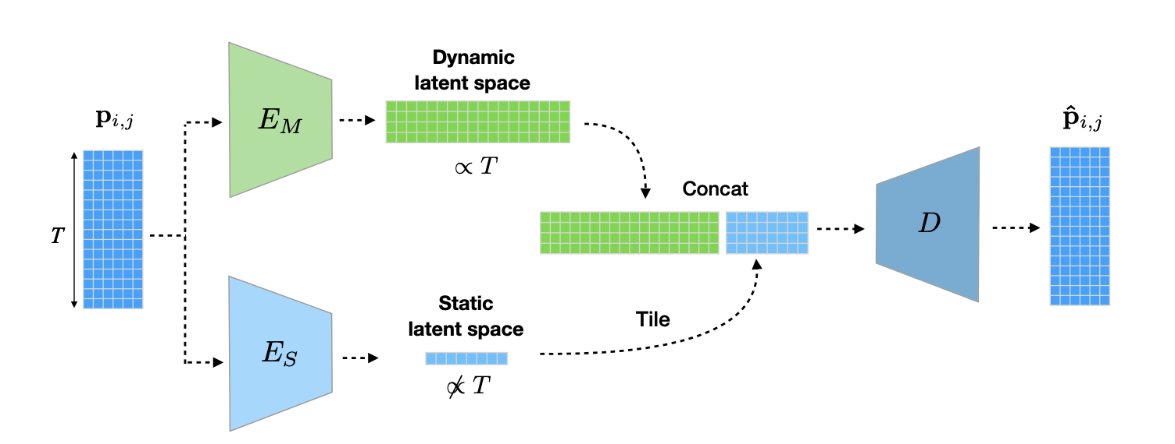
2D joints → 2D joints
Method
Input / Output

Slide 5
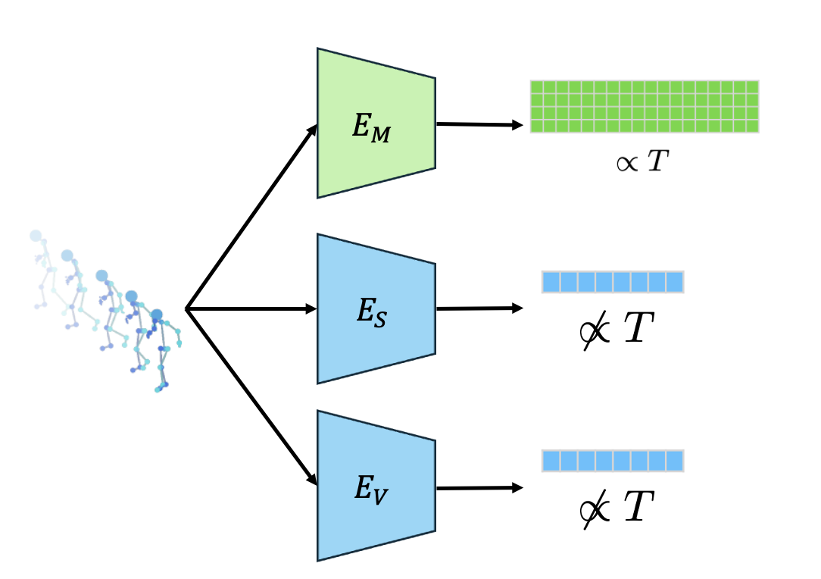
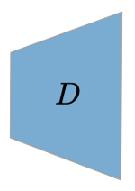
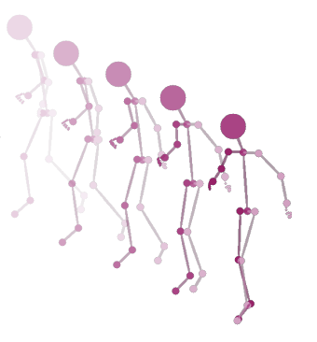

Introduction
(Motion A)
(Motion B)

Slide 6
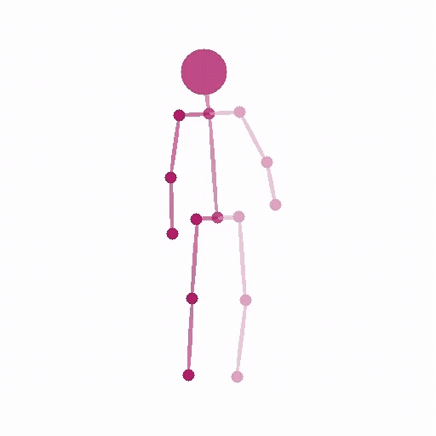
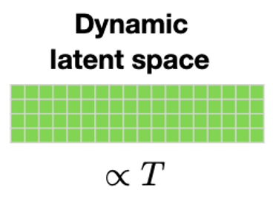
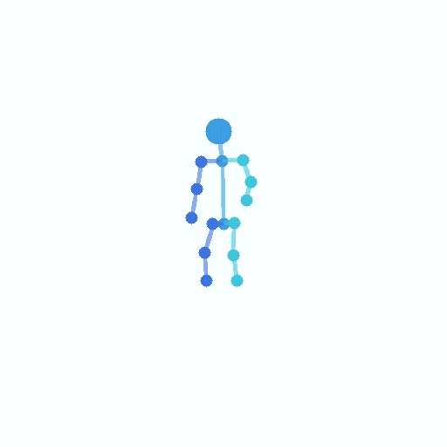
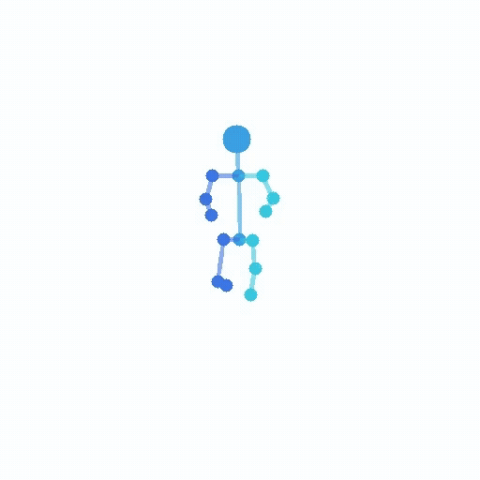
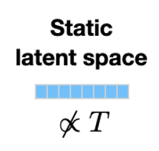

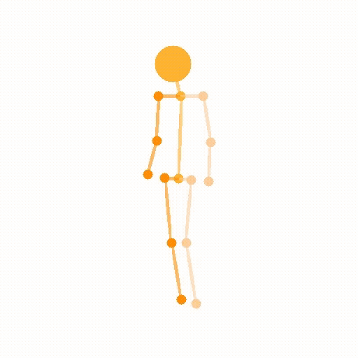
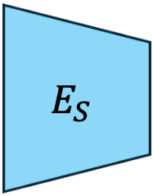
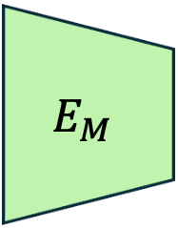
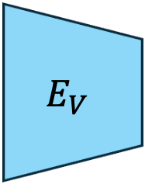
Introduction
$$E_{M}$$
(Motion)
$$E_{S}$$
(Result)
(Skeleton)
$$E_{V}$$
(view)

Slide 7
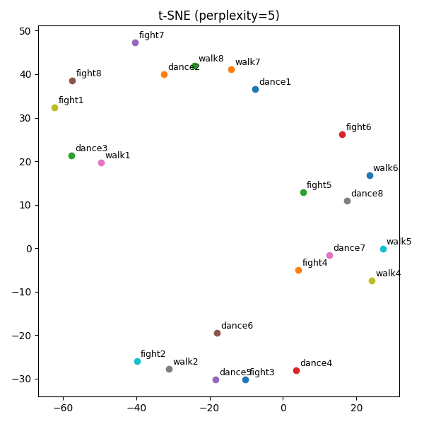
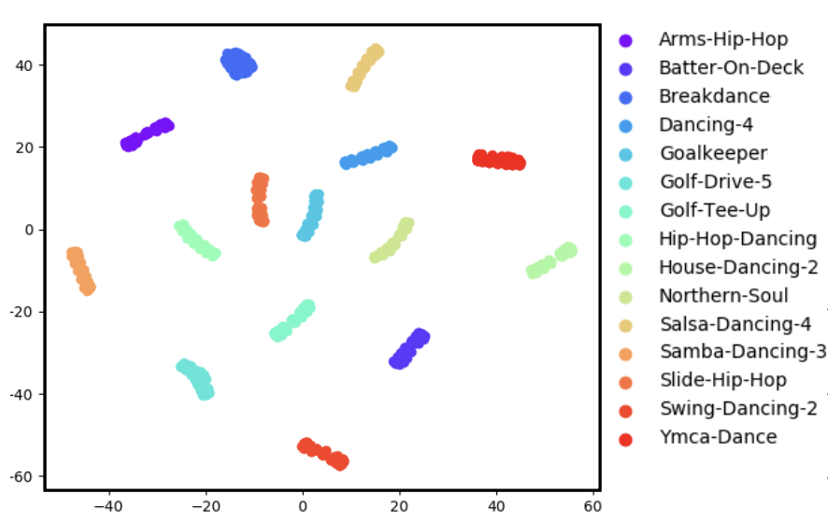
Results
Claim
Reality

