Slide 1
HOLD : Category-agnostic 3D Reconstruction of Interacting Hands and Objects from Video
Zicong Fan, Maria Parelli, Maria Eleni Kadoglou, Muhammed Kocabas, Xu Chen, Michael J. Black, Otmar Hilliges
CVPR2024

Slide 2
We interact with 140 objects per day

Slide 3
기존 References
- pre-scanned object template
=> infeasible to scale to in-the-wild scenarios
- datasets with a limited number of objects
=> poor generalization

Slide 4
HOLD (Hand and Object reconstruction by Leveraging interaction constraints in three Dimensions)

Slide 5
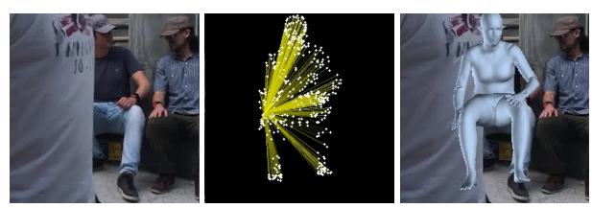
STEP 1 : Pose initialization
Hand Pose
- off-the-shelf hand pose estimator : METRO(MEsh TRansfOrmer, CVPR 2021)
=> hand poses, shape, global rotation, translation

Slide 6
STEP 1 : Pose initialization
Object Pose
- Create object-only images via segmentation network (Segment Anything, ICCV 2023)

Slide 7
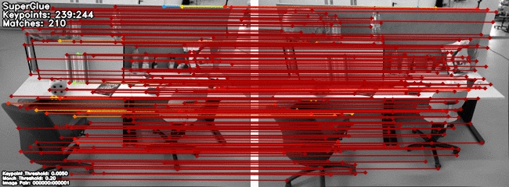
STEP 1 : Pose initialization
Object Pose
- Use “SuperGlue: Learning Feature Matching with Graph Neural Networks, CVPR 2020” for multi-view matching

Slide 8
STEP 1 : Pose initialization
Object Pose
- Perform structure-from-motion (SfM) to obtain a point cloud
-Point cloud defines the object and its rotation and translation

Slide 9
STEP 1 : Pose initialization
Aligning the hand and object
-Encourages hand-object contact
-2D reprojection of hand joints and the object point cloud
-to match with the original 2D projection
-Updates hand and object translation, hand shape, and object scale

Slide 10
STEP 2 : HOLD-Net training

Slide 11
STEP 2 : HOLD-Net training - Hand Model
- Model the hand via MANO pose, global rotation, and translation
- Sample n points for the hand
- Map points in the observation space x’ back to the canonical space x using inverse LBS
- Predict signed distance values to the hand surface d and color c using multi-layer perceptron
$$\{x'\}_{i = 1,..., n}^{h}$$

Slide 12
STEP 2 : HOLD-Net training - Object Model
- Sample n points for the object along the same ray
- Map points in the observation space x’ back to the canonical space x using a simple rigid transformation
-Predict signed distance d and color c using MLP
$$\{x'\}_{i = 1,..., n}^{o}$$

Slide 13
STEP 2 : HOLD-Net training - Background
-Use a time-dependent NeRF++ to model the dynamic background.
-Define a bounding sphere of the foreground scene(i.e. hand and the object)
-For a given sample outside the bounding sphere, the signed distance and color are predicted.

Slide 14
STEP 2 : HOLD-Net training - Compositional volumetric rendering
- Sort and Merge the two sets(hand, object) of samples via their depth value
=> Foreground color
- Background color is determined by density and color of sampled points of background
- Composite background and foreground => Final color

Slide 15
STEP 3 : Pose refinement
Refine hand and object pose parameters with mesh-based constraints
Encourage contact between frequently contacted hand vertices
and the object vertices by reducing the distances between them
$$V_{tips}$$

Slide 16
STEP 4 : Final training
Given the refined parameters, fully train HOLD-Net
HOLD-Net is pre-trained with half the number of epochs compared to this full-training stage for computational efficiency

Slide 17
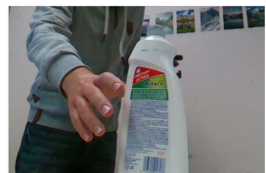
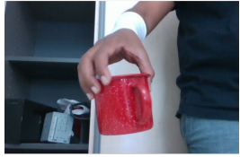
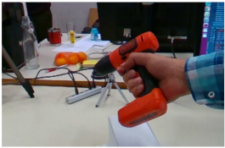
Experiments -Dataset
In-the-lab dataset : HO3D-v3
- Consists of RGB videos of a human hand manipulating a rigid object
- Provides accurate 3D annotations for MANO hand parameters and object poses
- None of the existing baselines are trained using HO3D (for generalization)
In-the-wild sequences
- in-door &out-door scenes
- 1st-person view & 3rd-person static view

Slide 18
Experiments - Metrics
MPJPE (Mean Per Joint Position Error)
to measure hand pose error
Chamfer Distance(CD)
to evaluate object reconstruction quality
F-score (F5, F10)
to measure local shape details
Hand-relative Chamfer Distance( )
to measure object pose and shape relative to the hand in 3D
$${CD}_{h}$$

Slide 19
Experiments - State of the art comparison
Hand-object reconstruction
- Existing methods do not assume an object template

Slide 20
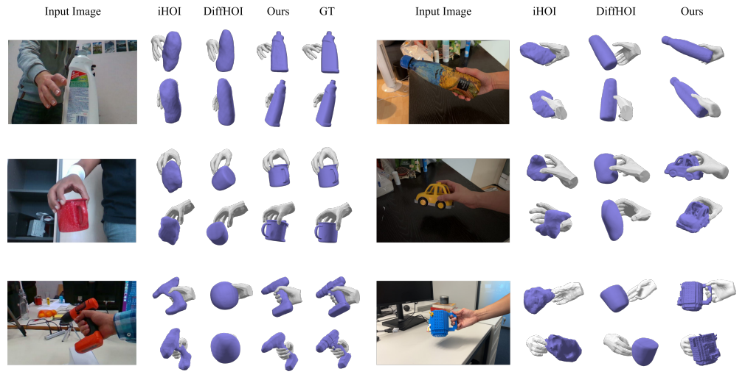
Experiments - State of the art comparison
Hand-object reconstruction
car
frame
mug handle

Slide 21
Experiments - State of the art comparison
Generalization
split HO3D sequences according to whether they belong to the training categories of DiffHOI
our method has consistent performance on all categories
our method significantly outperforms DiffHOI even for its training categories

Slide 22
Experiments - State of the art comparison
Generalization
Water Bottle : in the DiffHOI’s training dataset
drill : outside of DiffHOI’s training dataset

Slide 23
Experiments - State of the art comparison
In-hand object scanning

Slide 24
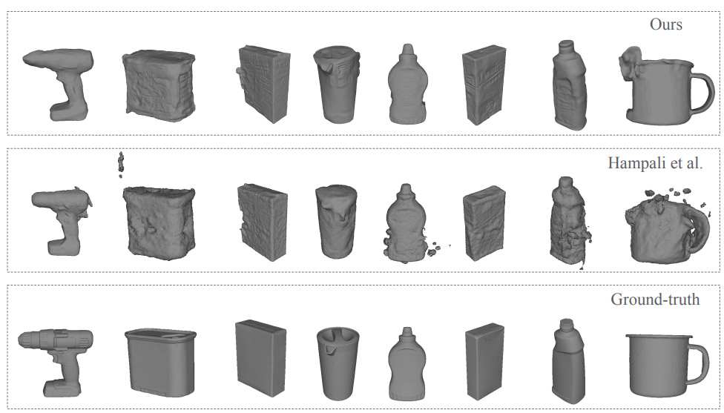
Experiments - State of the art comparison
In-hand object scanning
more details, fewer artifacts, more closer to the ground-truth

Slide 25
Experiments - Ablation
Joint hand-object reconstruction & Contact-based hand-object pose refinement
Modelling the hand and object jointly improves object reconstruction accuracy
Pose refinement improves object and hand poses

