Slide 1
Joint Reconstruction of 3D Human and Object via Contact-Based Refinement Transformer
Hyeongjin Nam, Daniel Sungho Jung, Gyeongsik Moon, Kyoung Mu Lee
CVPR2024

Slide 2
CONTHO(CONTact-based 3D Human and Object reconstruction)

Slide 3
Simplified pipeline of CONTHO

Slide 4
Simplified pipeline of CONTHO
3D-guided contact estimation

Slide 5
Simplified pipeline of CONTHO
contact-based 3D human and object refinement

Slide 6
Overall pipeline of CONTHO

Slide 7
Overall pipeline of CONTHO

Slide 8
Overall pipeline of CONTHO
1) 3D vertex feature extraction
2) Human-object contact estimation

Slide 9
Overall pipeline of CONTHO
1) Contact-based masking
2) 3D human and object refinement

Slide 10
Experiments
1. Datasets
BEHAVE
InterCap

Slide 11
Experiments
2. Evaluation metrics
- Precision & Recall for contact estimation
- Chamfer distance (between predicted and GT meshes)
- Precision & Recall for contact from reconstruction

Slide 12
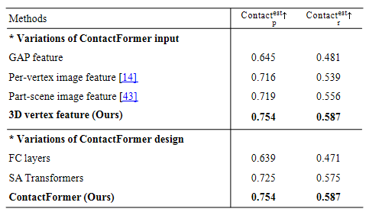
Experiments
3. Ablation study
1) Effectiveness of 3D-guided contact estimation

Slide 13
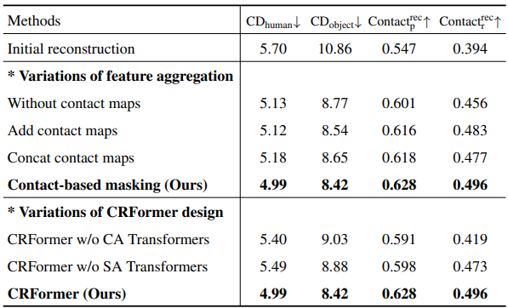
Experiments
3. Ablation study
2) Effectiveness of contact-based refinement

Slide 14
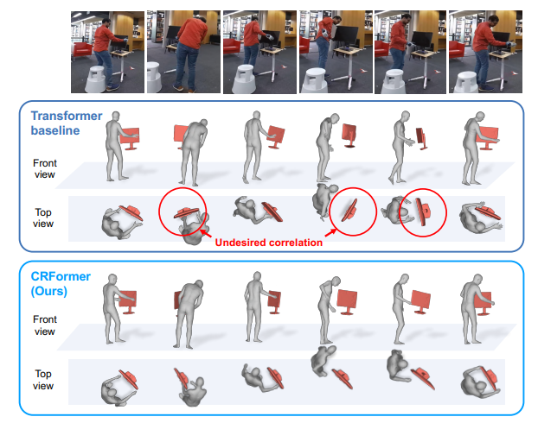
Experiments
3. Ablation study
3) Analysis of undesired human-object correlation

Slide 15
Experiments
3. Ablation study
3) Analysis of undesired human-object correlation

Slide 16
Experiments
3. Ablation study
3) Analysis of undesired human-object correlation

Slide 17
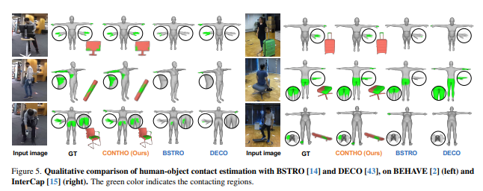
Experiments
4. Comparison with state-of-the-art methods
1) Human-object contact estimation

Slide 18
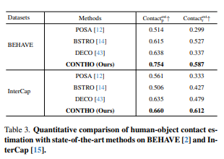
Experiments
4. Comparison with state-of-the-art methods
1) Human-object contact estimation

Slide 19
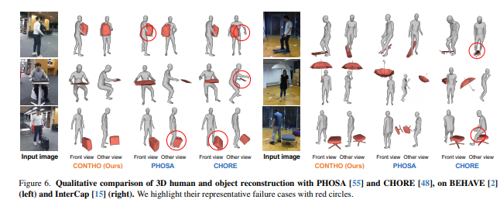
Experiments
4. Comparison with state-of-the-art methods
2) 3D human and object reconstruction

Slide 20
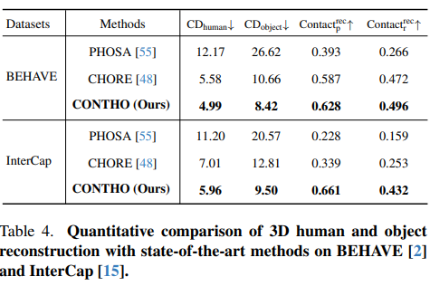
Experiments
4. Comparison with state-of-the-art methods
2) 3D human and object reconstruction

Slide 21
