Slide 1
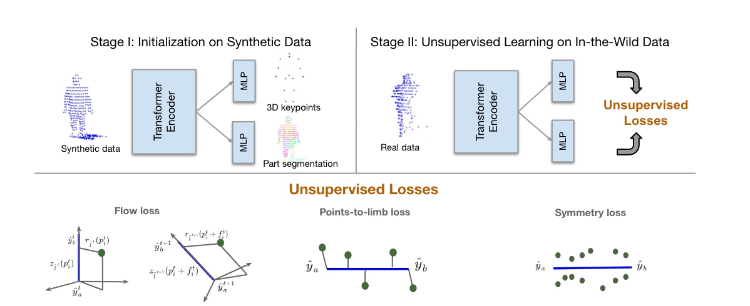
3D Human Keypoints Estimation from Point clouds in the Wild Without Human Labels
In CVPR 2023
Stanford University, Waymo
DaeYong Kim
Dept. of Artificial Intelligence, Ajou University

Slide 2
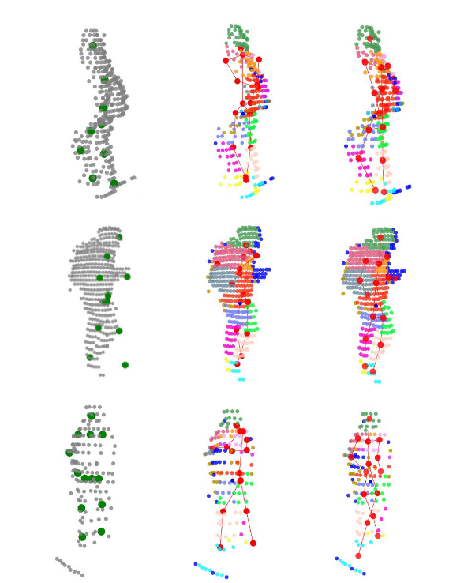
Contents
Goal
2. Prior works
3. Propose : GC-KPL
4. Process
4-1. Stage I
4-2. Stage II
5. Losses
5-1. Flow Loss
5-2. Points-to-Limb Loss
5-3. Symmetry Loss
5-4. Joint-to-Part Loss
5-5. segmentation Loss && Training objective
6. evaluation

Slide 3
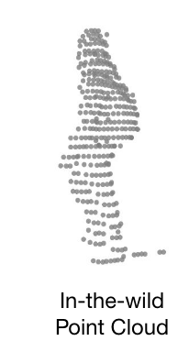
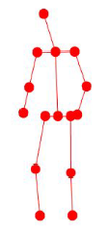
Goal
3D human keypoints estimation from point clouds in the Wild
3D keypoints predictor
LiDAR
Unsupervised

Slide 4
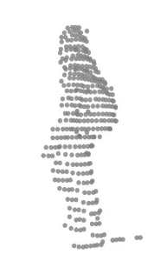
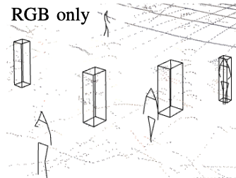
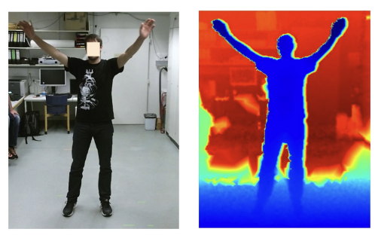
Prior works
Supervision
Label
3D keypoints predictor
+
Prior work)
3d data + label : expensive
focus on utilizing 2d weak data
This work)
un-labeled LiDAR data has a lot of useful information
weak Supervision : RGB, depth, etc…
3D keypoints predictor
- M. Furst, S. T. P. Gupta, R. Schuster, O. Wasenmuller, and D. Stricker, "HPERL: 3D human pose estimation from RGB and LiDAR,” IEEE, 2021
- J. Zheng, X. Shi, A. Gorban, J. Mao, Y. Song, C. R. Qi, T. Liu, V. Chari, A. Cornman, Y. Zhou, and others, “Multi-modal 3D human pose estimation with 2D weak supervision in autonomous driving,” IEEE, 2022

Slide 5
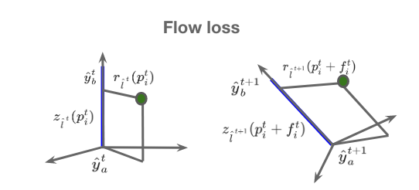
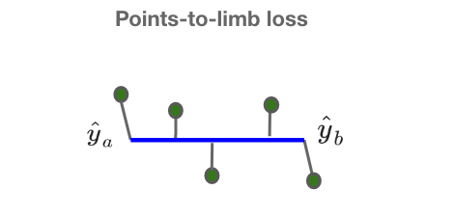
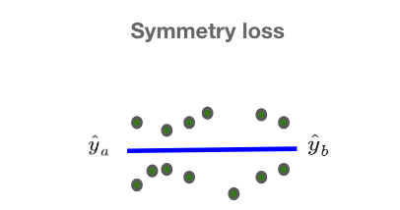
Propose : GC-KPL
GC-KPL : Geometry Consistency inspired Key Point Leaning
Assumptions
- human skeletons are roughly centered rigid body parts
- surface points : “location + movement” -> skeleton “movement”
propose
- novel unsupervised losses term
- Flow Loss
- Points-to-Limb Loss
- Symmetry Loss

Slide 6
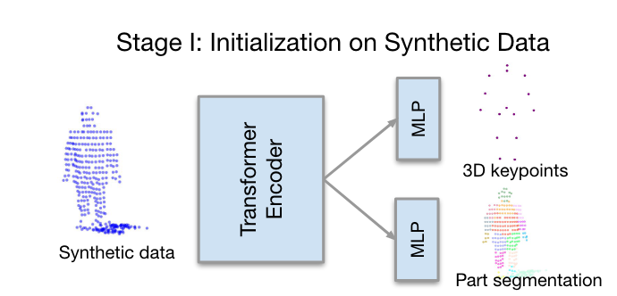
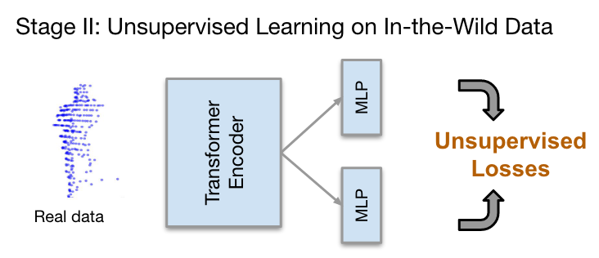
Process - Overall
Stage I – Warm Up
Stage II – refine the network
transformer-based regression model : keypoints
semantic segmentation model : localizing body parts on a synthetic data
synthetic data : constructed from randomly posed SMPL human body model
Using unsupervised Losses
Flow Loss
Points-to-limb Loss
Symmetry Loss

Slide 7
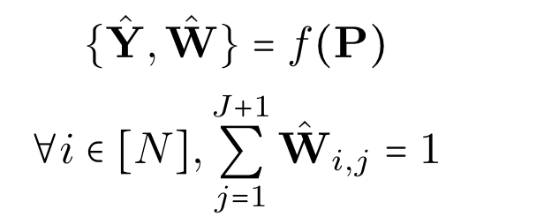
Process – Stage I : Input & Output
Input : Point Clouds
Output : {3D keypoints, Part segmentation}
<Keypoints : L2 Loss>
<segmentation : Cross-Entropy Loss>
<Minimize>
$\hat{Y}$: 3D Locations of keyPoints
$\hat{W}$: probability of each point i(body parts || background)

Slide 8
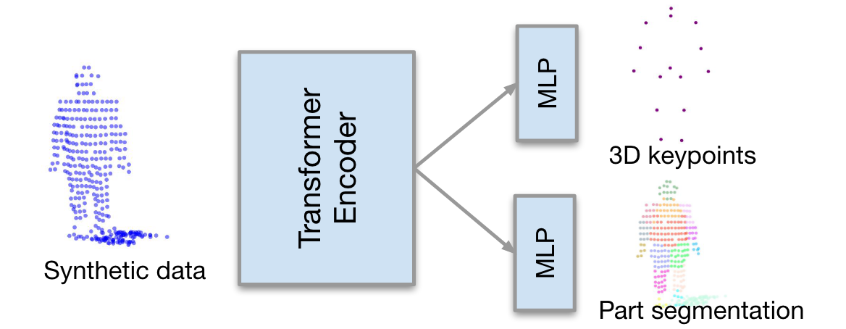
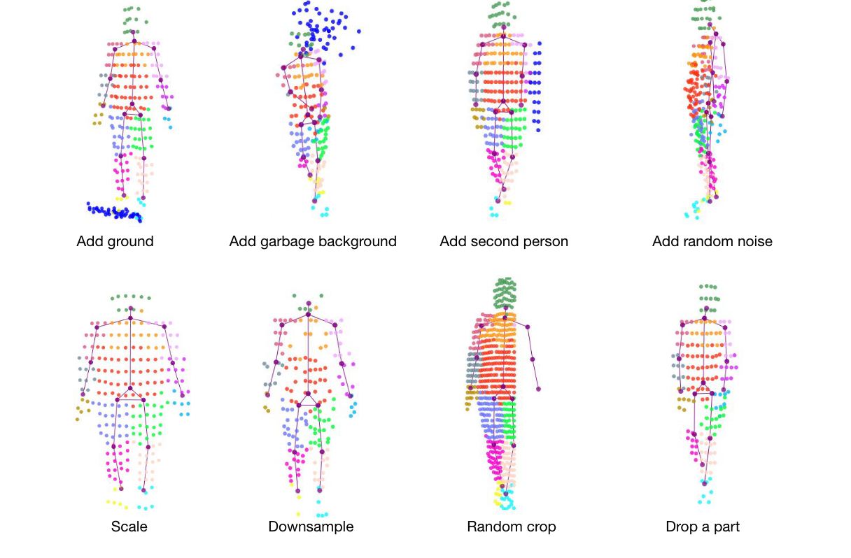
Process – Stage I
3D human keypoints estimation from points clouds in the wild
L2
-> regression
Cross Entropy
-> classification
- Add ground
- Add garbage background
- Add random noise
- Scale
- Downsample
- Random crop
- Drop a part
<augmentation>

Slide 9
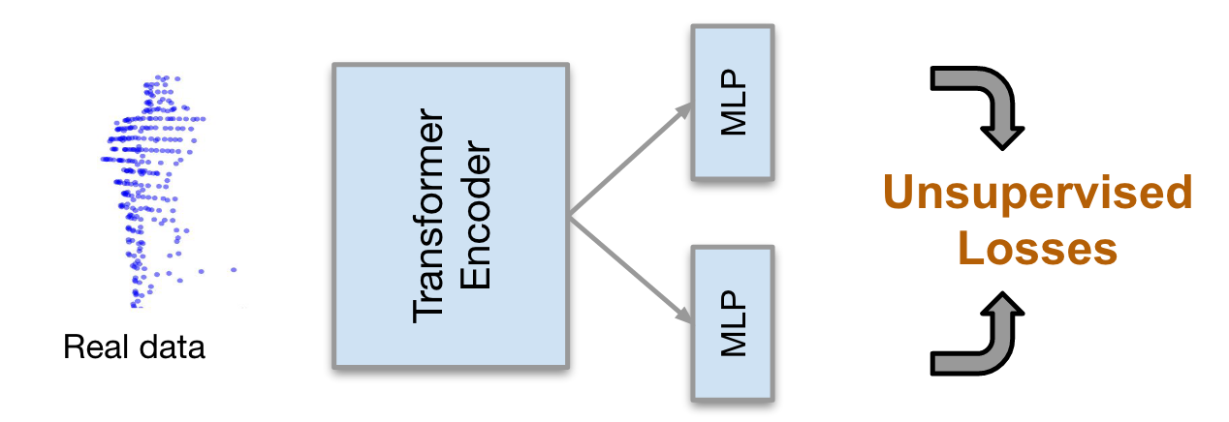
Process – Stage II
3D human keypoints estimation from points clouds in the wild
points clouds -> set of points {x, y, z}

Slide 10
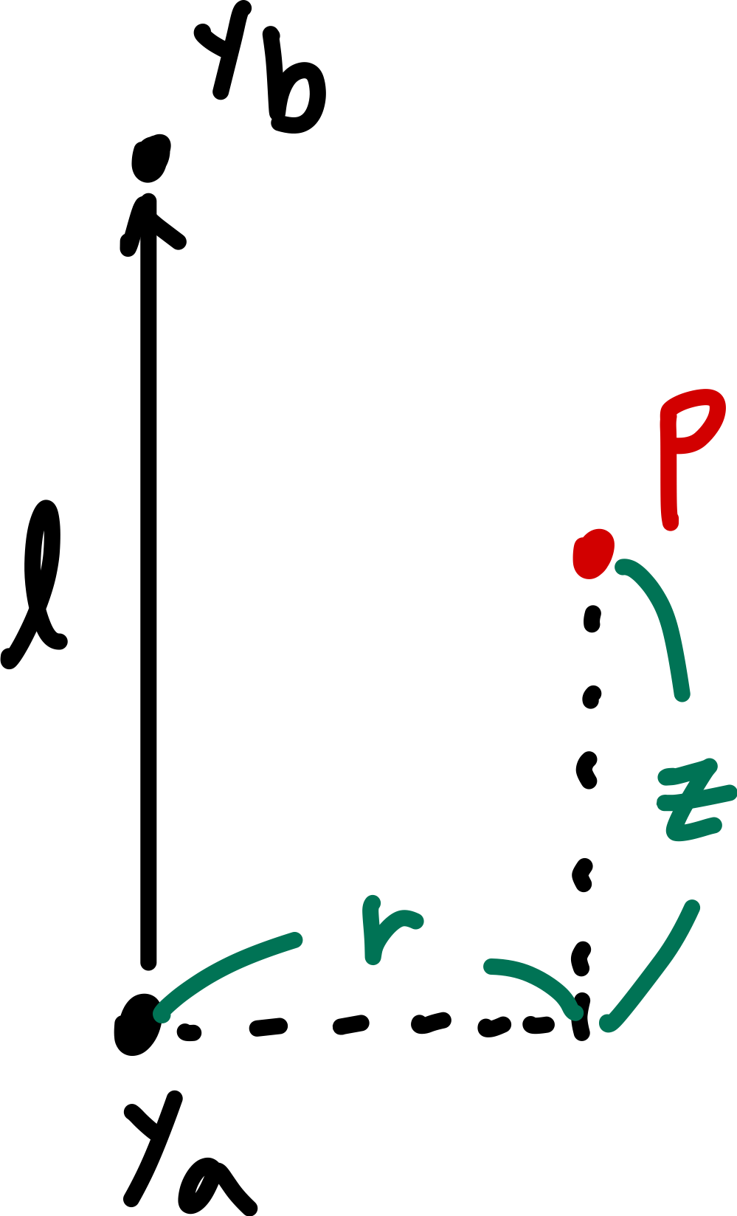
Losses
- L : human skeleton composed of limbs
- $y_{a}$ : parent keypoint
- $y_{b}$ : child keypoint
: Limb
: axial
: radial
: The probability of each point I belonging to body part a
points → each limbs’ local cylindrical coordinate

Slide 11
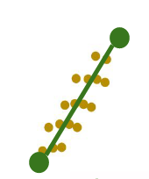
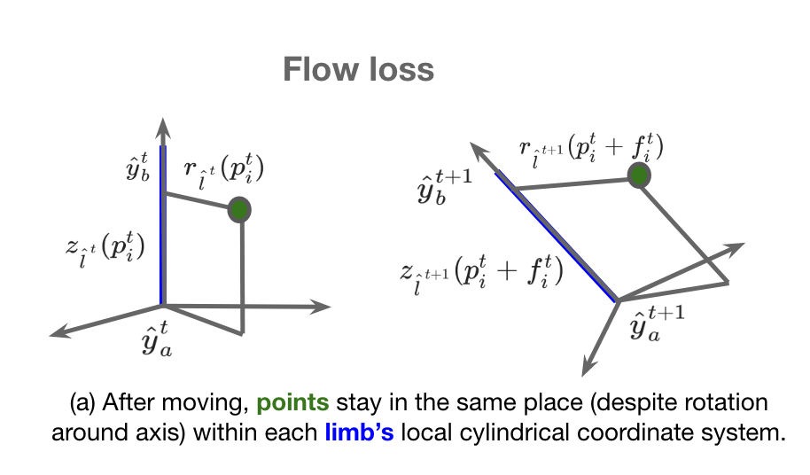
Losses – Flow Loss
- For considering the predictions from two consecutive frames
- For consistency of the radial and altitude components of all points with respect to scene flow
<Forward Flow>
<forward Flow>
<backward Flow>
t
<backward Flow>
t+1
<Flow loss = Forward + backward>

Slide 12
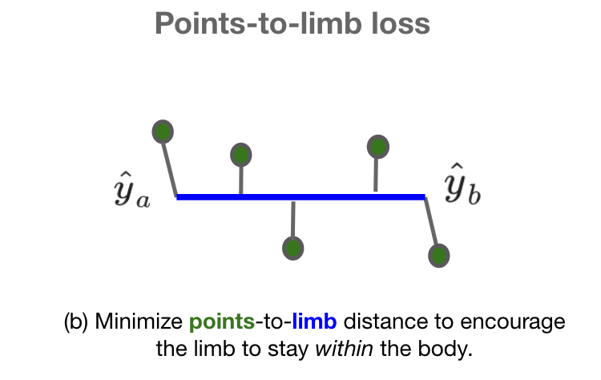
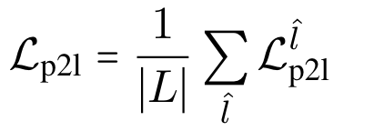
Losses – Points-to-Limb Loss
d : L2 distance function(point <-> limb)
<Points-to-Limb loss = Sum over all points>
- To minimize the distance of the points to the corresponding limb

Slide 13
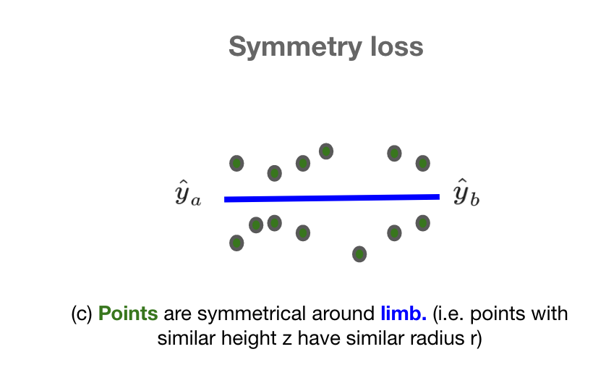
Losses – Symmetry Loss
: weighted mean of radial values of points
: Gaussian kernel with bandwith h
<Symmetry loss = Sum over all points>
- to encourage that all points around the limb are roughly symmetrical around it

Slide 14
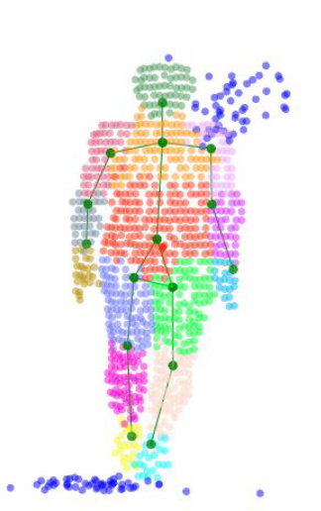
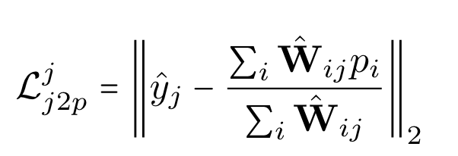
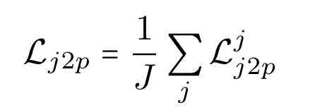
Losses – Joint-to-Part Loss(Optional)
- To encourage each joint to be close to the center of the points on that part
<Joint-to-part loss = Sum over all Joints>

Slide 15
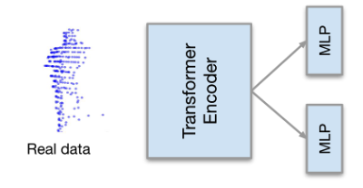
Losses – segmentation Loss && Training objective
Before Stage II
$${\hat{W}}_{1}$$
One-hot encoding
Stage II : Start Training
$$\hat{Y}$$
unsupervised Losses
$${\hat{W}}_{2}$$
Cross-Entropy Loss
unsupervised Loss
$${\hat{W}}_{1}$$

Slide 16
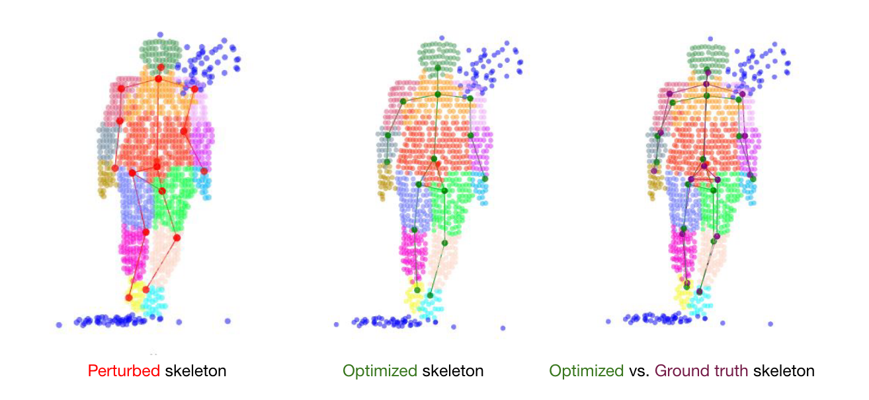
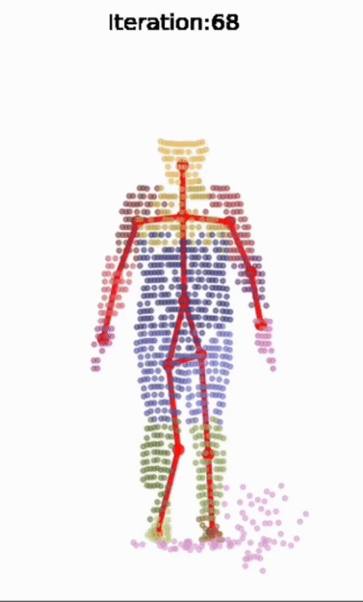
Evaluation
hyper-parameter
$λ_{kp}=0.5$
$λ_{seg}=1$
$λ_{flow}=0.02$
$λ_{p2l}=0.01$
$λ_{sym}=0.5$
$λ_{j2p}=2$
$λ_{seg}=0.5$
the result of applying the losses

Slide 17
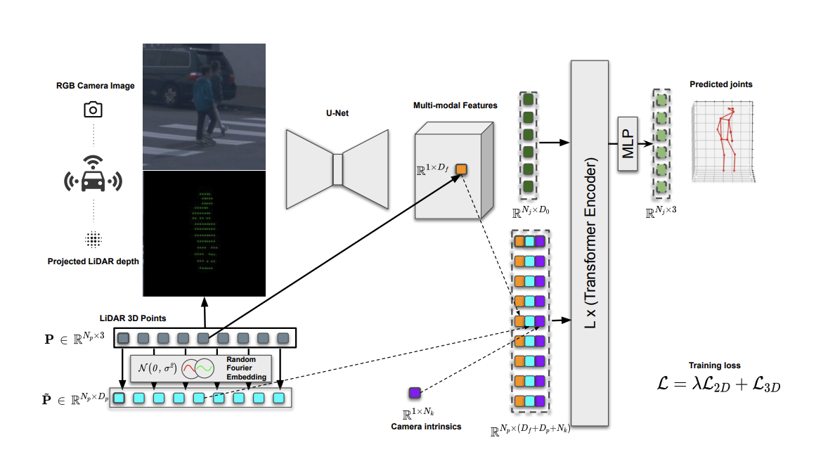
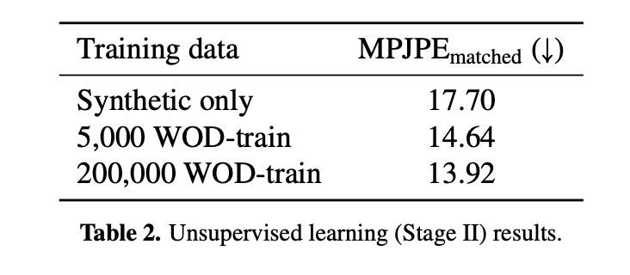
Evaluation
HUM3DIL : Image + LiDAR
-A. Zanfir, M. Zanfir, A. Gorban, J. Ji, Y. Zhou, D. Anguelov, and C. Sminchisescu, “Hum3dil: Semi-supervised multi-modal 3D human pose estimation for autonomous driving” CoRL 2022

