Slide 1
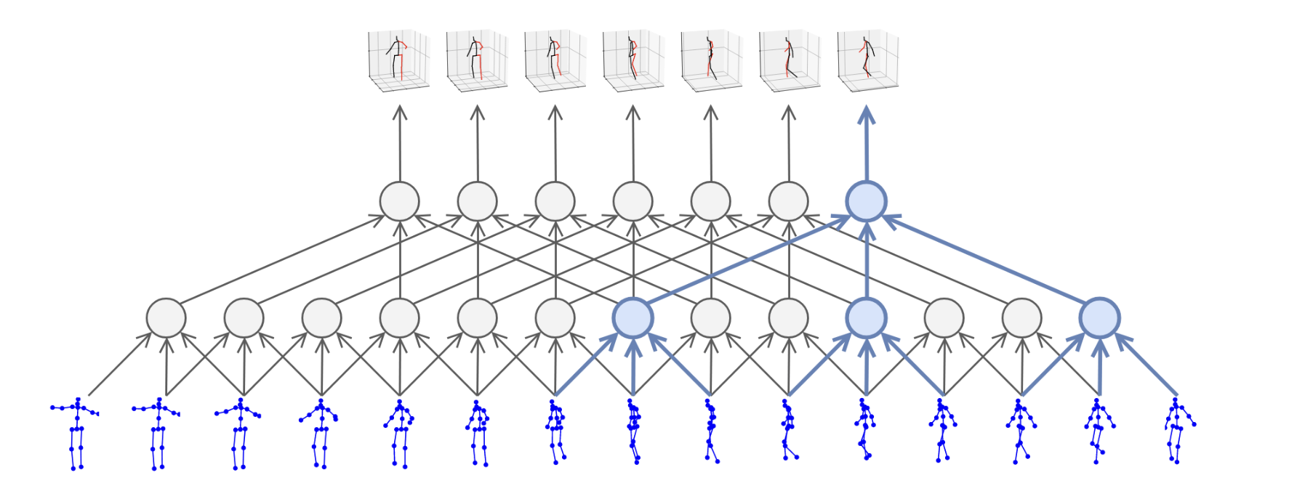
3D human pose estimation in video with temporal convolutions and semi-supervised training
In CVPR 2019
Facebook AI Research

Slide 2
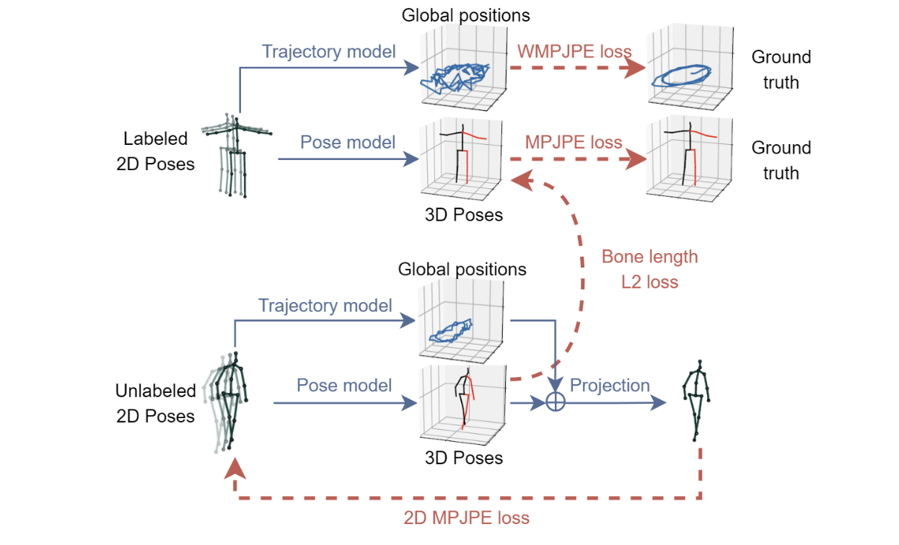
Contents
Purpose
2. background
2-1. TCN
2-2. casual network
2-3. dilated TCN
3. Total Flow
3-1. Network
3-2. semi-supervised
4. evaluation

Slide 3
Purpose
3D human pose estimation in video

Slide 4
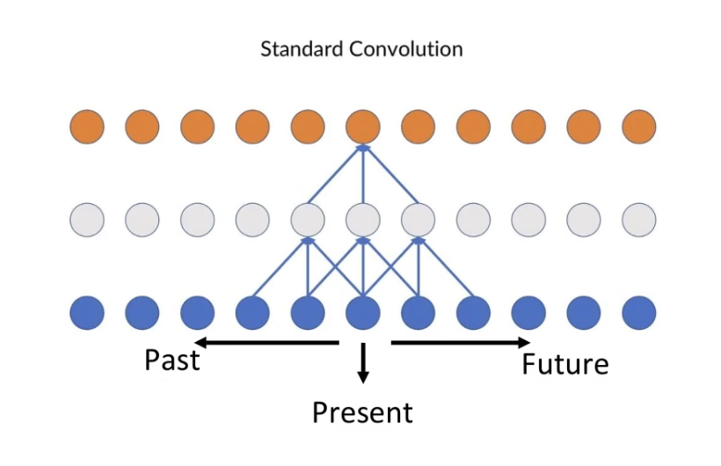
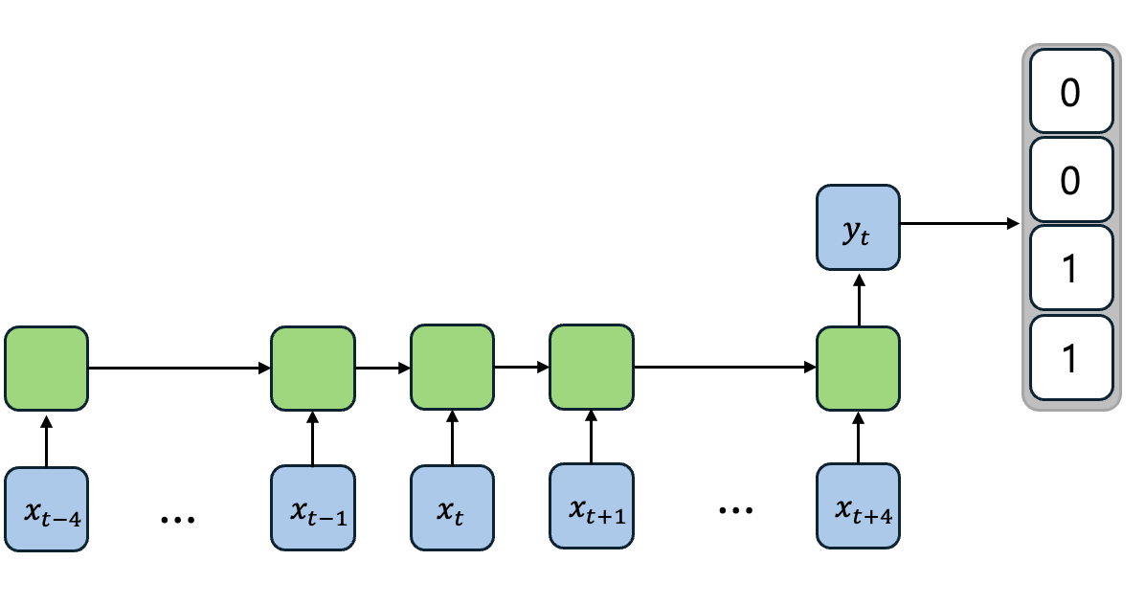
background – TCN
Temporal Convolution Network
RHeel
RBigToe
LHeel
LBigToe
<TCN>
<RNN>
Notes:
일반적으로 seqeunce modeling에 rnn을 사용하는데, sequence modeling에 사용할 수 있는 cnn 모델입니다.
장점으로는

Slide 5
background – TCN
Temporal Convolution Network
<Advantages>
Parallelism
Flexible receptive field size
Stable gradients(exploding / vanishing gradient problem along the time axis)
Notes:
장점으로는 병렬계산 가능,
Field size가 유연
그레디언트각 안정적

Slide 6
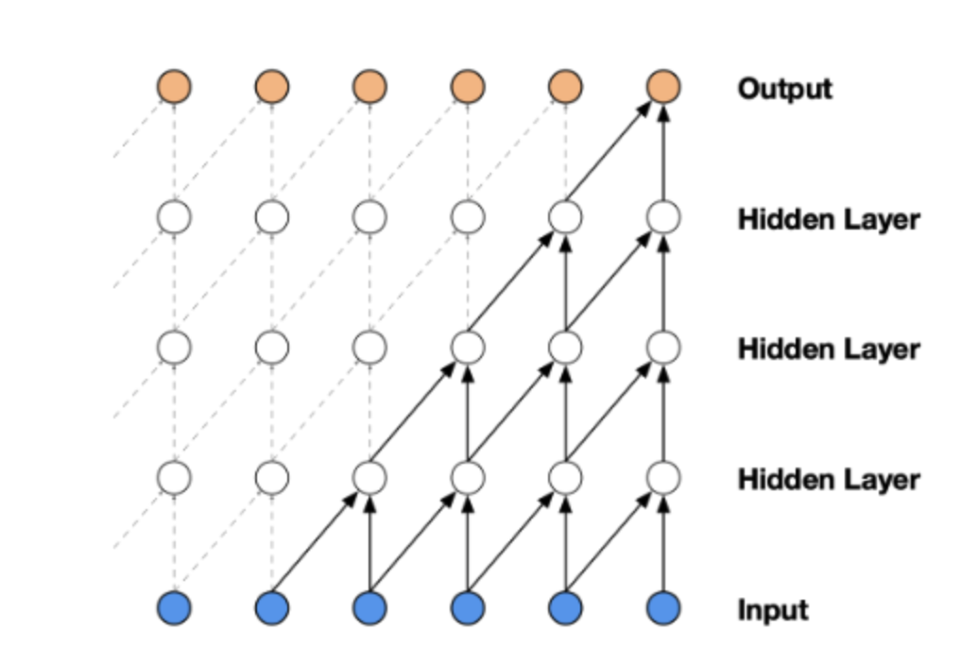
background – Causal TCN
input sequence : $x_{0}, …,x_{T}$
output sequence : $y_{0}, …,y_{T}$
$y_{t}$<- input($x_{i}, …,x_{t})$
Notes:
Convolution 연산 시에 timestep t의 output을 계산하기 위해서 time t와 이전 시점의 요소들만 이용.

Slide 7
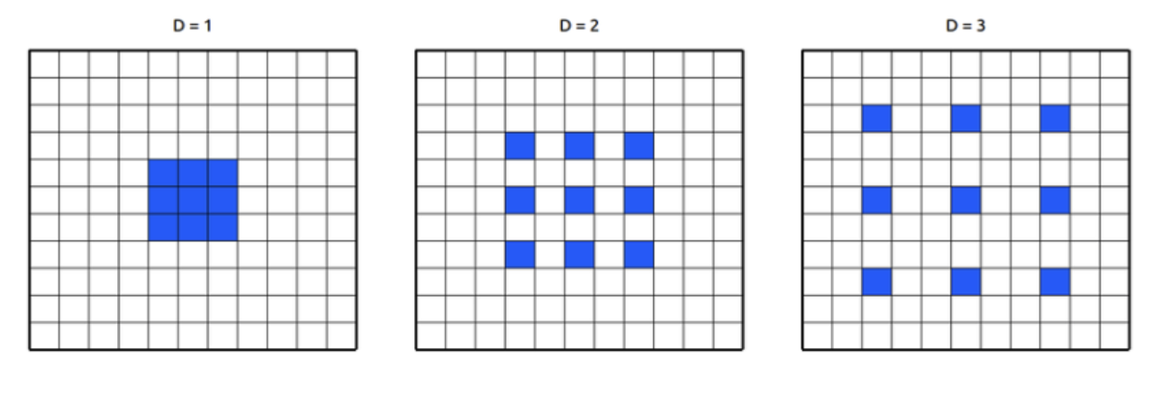
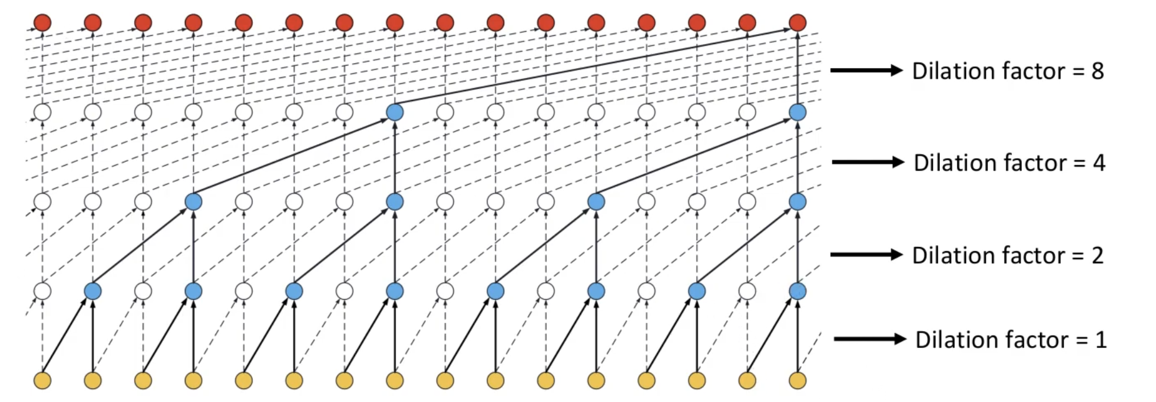
background – Dilated TCN
Dilated Convolution
<Advantages>
An effective way to make the Receptive Field large -> increase in computation x
Dilated TCN
Notes:
Receptive field를 크게 만들면서 연산량의 증가를 가져오지 않는 방법. Receptive field : 하나의 노드가 보는 영역

Slide 8
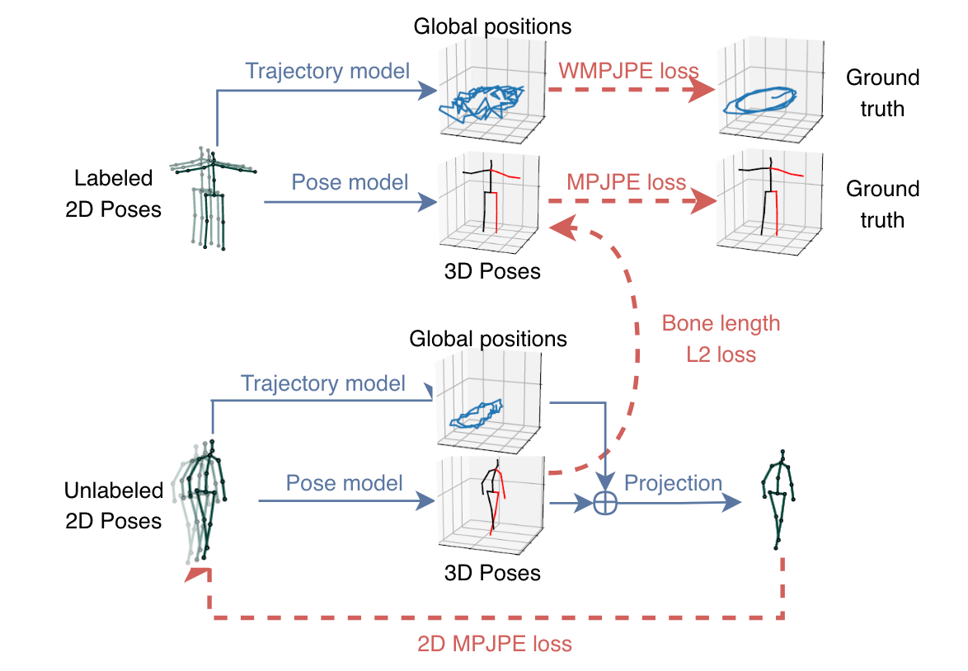
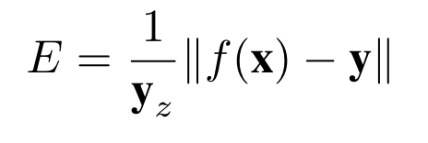
Total Flow
temporal convolutions and semi-supervised training
<data>
labeled 2D Poses <-> mocap data
Un-labeled 2D Poses
WMPJPE
$$y_{z}:gt depth in camera space$$
<each network>
The two networks have the same architecture but do not share any weights
Notes:
Receptive field를 크게 만들면서 연산량의 증가를 가져오지 않는 방법. Receptive field : 하나의 노드가 보는 영역
Bone length l2 loss : 관절 사이의 뼈 길이 loss

Slide 9
Network – Temporal dilated convolutional model
apply zero-padding, k = 3
$$x_{0}$$
$$x_{1}$$
$$x_{2}$$
$$x_{3}$$
input : (x, y) x joint x Timesteps
output : 3D poses for all frame
hyper-parameter)
kernel size : k
dilation factor : D
$$0$$
$$0$$
$$x_{0}$$
$$x_{1}$$
$$x_{2}$$
$$x_{3}$$

Slide 10
Network – Semi-supervised approach
main idea : cycle consistency
오늘 점심 뭐 먹지
What should I eat for lunch today?
compare
오늘 점심은 뭐 먹지
Cycle consistency)
maintaining its consistency when returning to its original state through a cyclical process

Slide 11
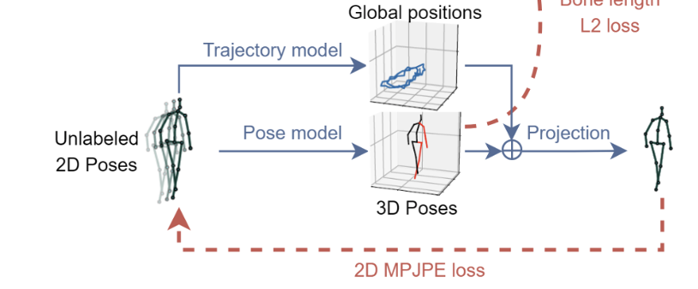
Network – Semi-supervised approach
OpenPose
2D joint pose
encoder
3D joint pose
unlabeled video
decoder
loss
2D joint pose

Slide 12
Network – Trajectory
Trajectory model : For perspective projection
2D pose on the screen depends on…
the global position of the human root joint(trajectory)
3D pose
<reason>
1. without global position, the subject would always be reprojected at the center of the screen with a fixed scale.

Slide 13
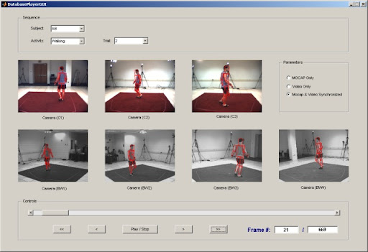
Evaluation – Datasets and Evaluation
Human3.6M
HumanEva-I
- 3.6 million video frames for 11 subjects,
of which seven are annotated with 3D poses
much smaller dataset, with three subjects recorded from three camera views

Slide 14
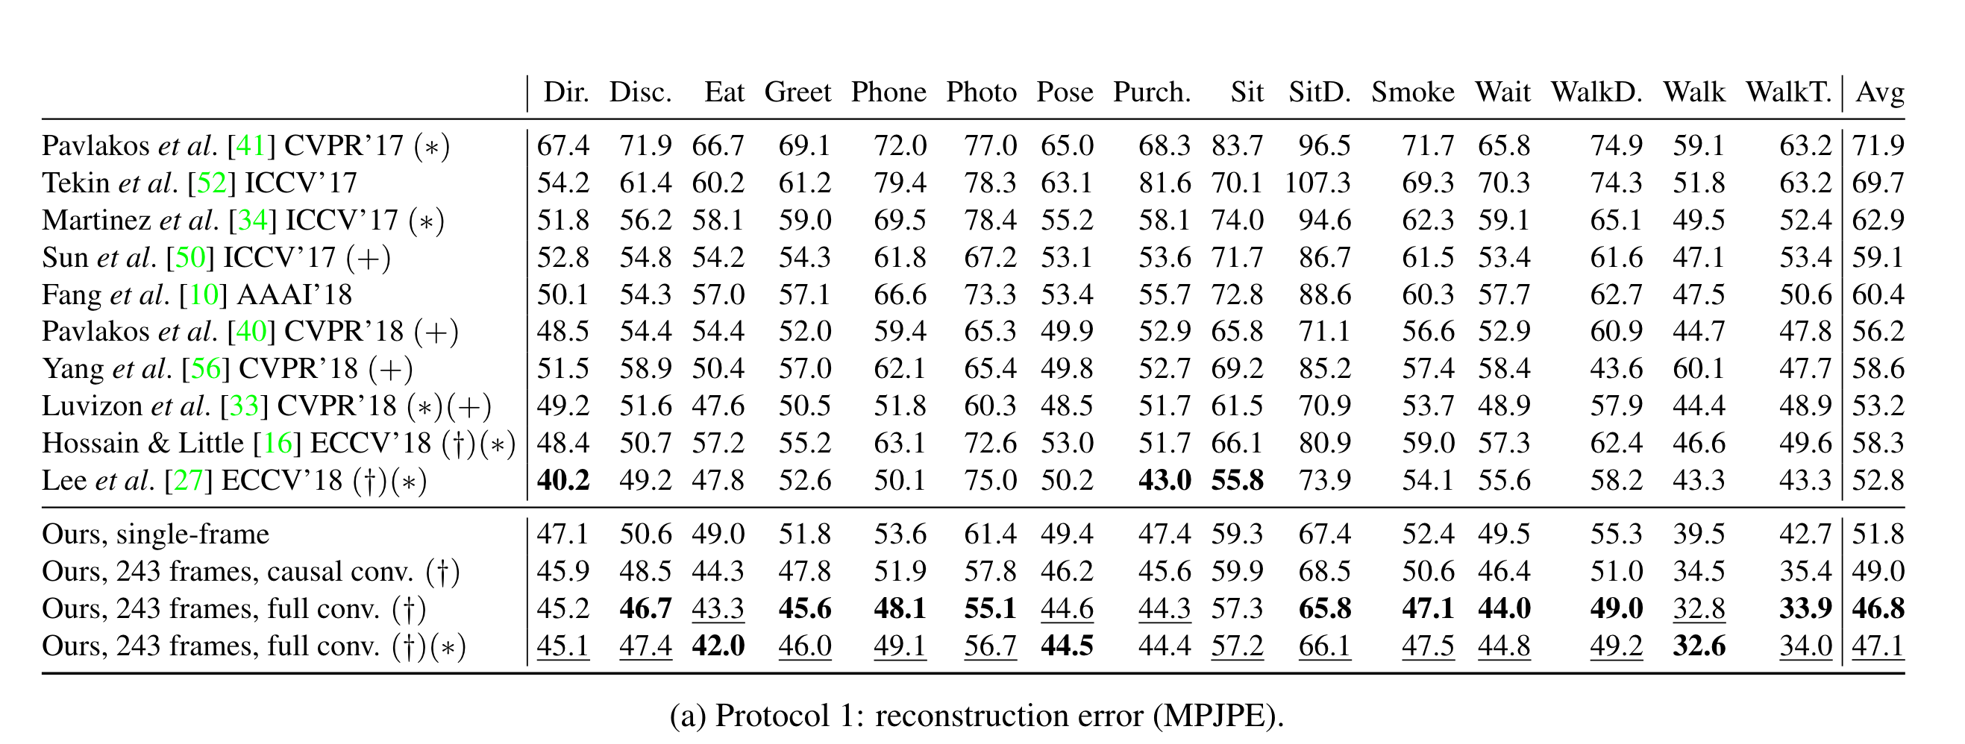
Evaluation – Datasets and Evaluation

